Slide 1
Writing Better Code
Improving code quality, reliability and, resilience, using techniques created by people much smarter than me
Patrick Alburtus
March 2022
Notes:
Intro Slide
Test
One
Two
Order one
Order two
Order three
Here is a note that is not bold

Slide 2
What the hell are we even talking about?
Defining the Problem
The definitions of clean vs dirty code is as varied as the minds and tastes of seasoned developers.
A good example of trying to define code that is clean is that it is like trying to explain why something abstract, such as a painting or photograph, is good.
This can be a particularly jarring observation for a junior programer or a non-technical stakeholder. After all isn’t software a development a science?

Slide 3
Let’s agree on unclean code
Defining the Problem
Since there is no accounting for taste in terms of defining clean code, let’s try laying out some commonly agreed on definitions of its opposite, code “rot”
Difficult to understand for anyone who is not the author
Becomes harder to understand over time
Complex dependencies
Lacks unit and acceptance testing
Difficult and time consuming to change!
Notes:
Lacking unit and acceptance testing could be sheer neglect or because the code is written in such a way that it difficult to write tests for in the first place.
Ask devs for other examples

Slide 4
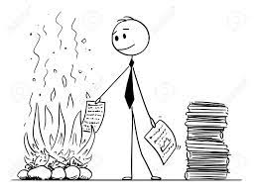
The Grand Redesign in the Sky
Bad Ideas
“Our drugs module is a mess! This code is hopeless, we need to rewrite the whole thing from scratch”

Slide 5


The Grand Redesign in the Sky
Bad Ideas
“However we have product deadlines”
HAHAHAHAHAHAHAHAHA
HAHAHAHAHAHAHAHAH
So listen, we just need to stop writing any new features for about 6 months. 8 Tops!
Product
Dev
Manager

Slide 6

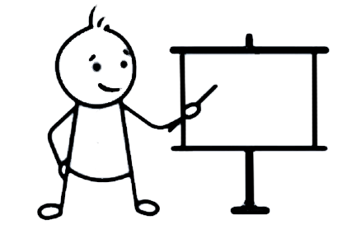
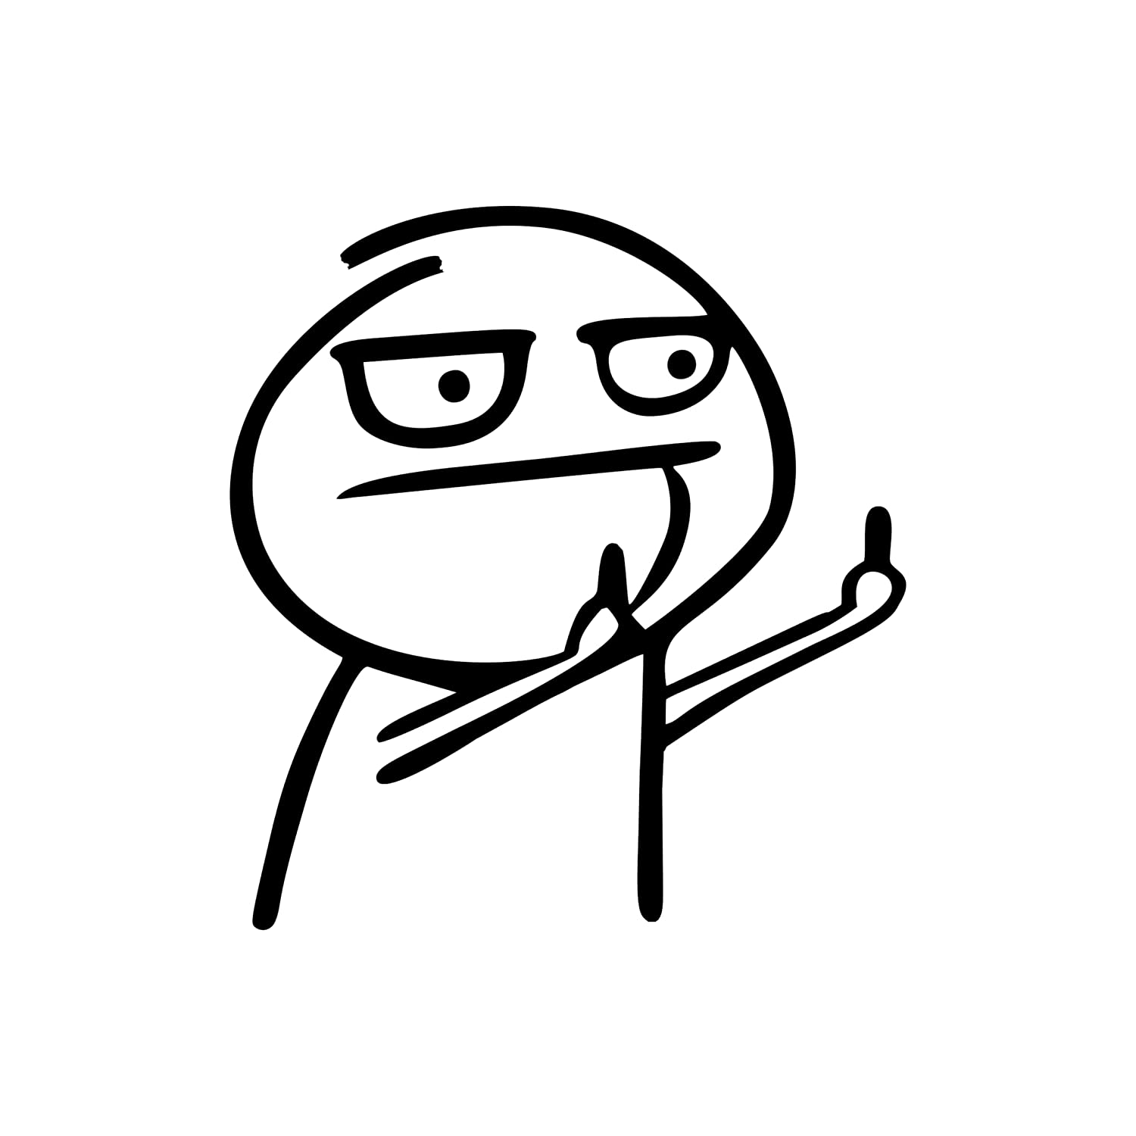
The Grand Redesign in the Sky
Bad Ideas
“Okay we are going to dedicate part of the team to work on the rewrite and others to maintain the code. It should only slow us down a little”
Where going to have two teams!
Rewrite
Team
Dev
Manager
Maintenance
Team

Slide 7

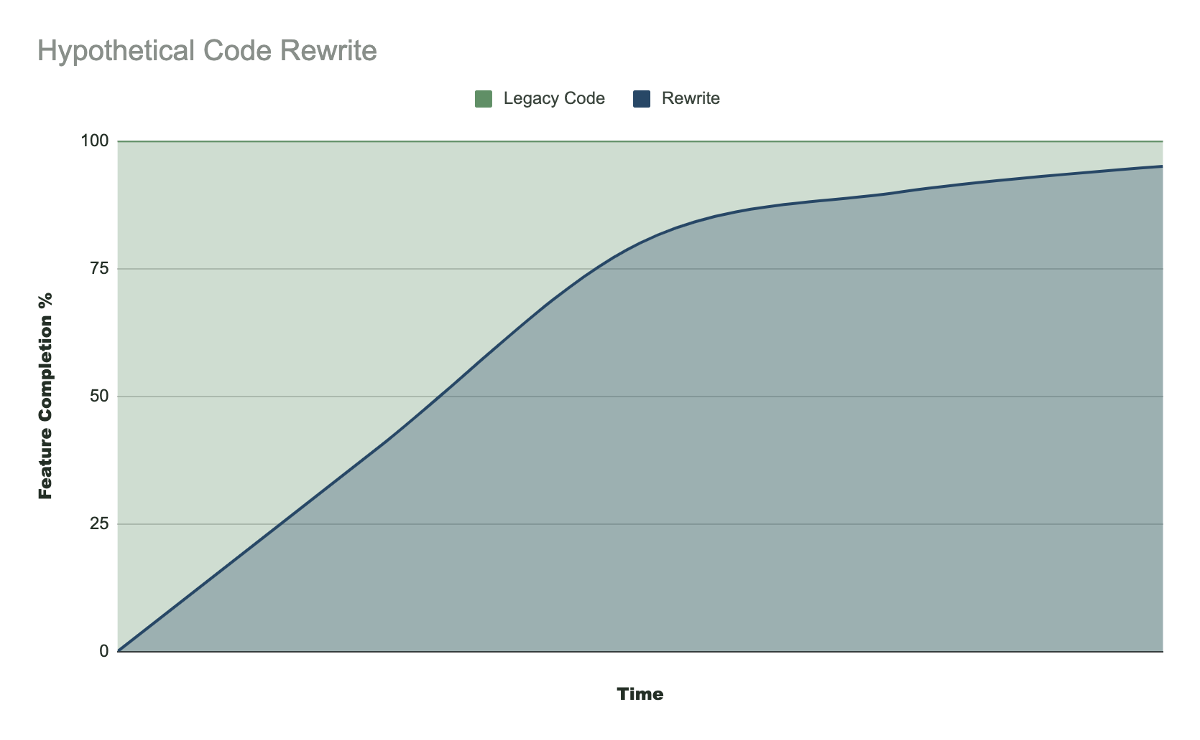
The Grand Redesign in the Sky
Bad Ideas
Notes:
For the redesign team, it starts of great, green field product, doing everything by the book, life is great…. Unless of course your not on the redesign team.

Slide 8
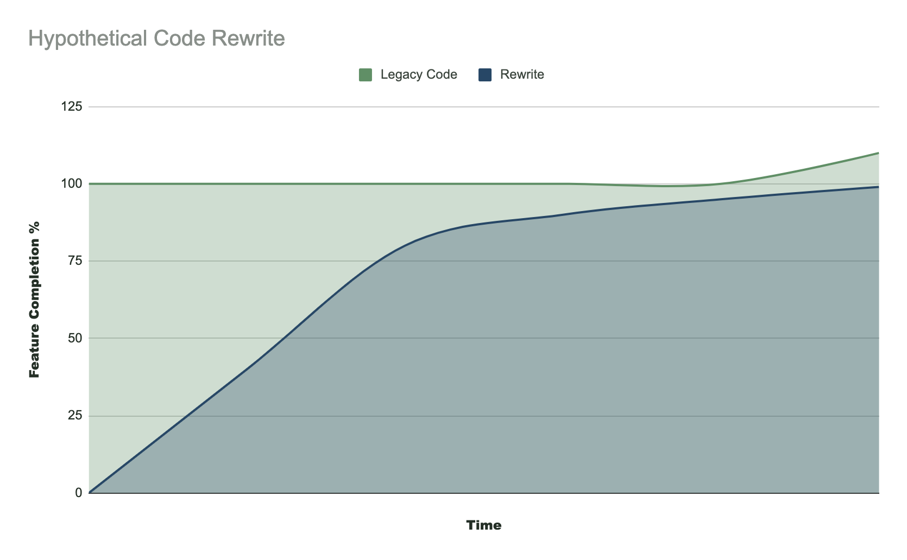
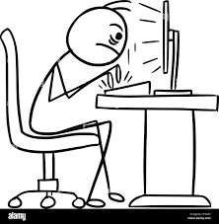
The Grand Redesign in the Sky
Bad Ideas
New Requirements
Notes:
All of the sudden new requirements come in, now the we’re not just trying to catch up to the original code base, now the scope of the rewrite has increased as well

Slide 9
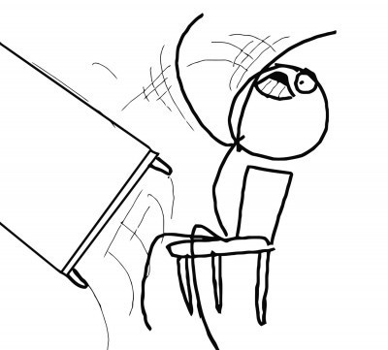
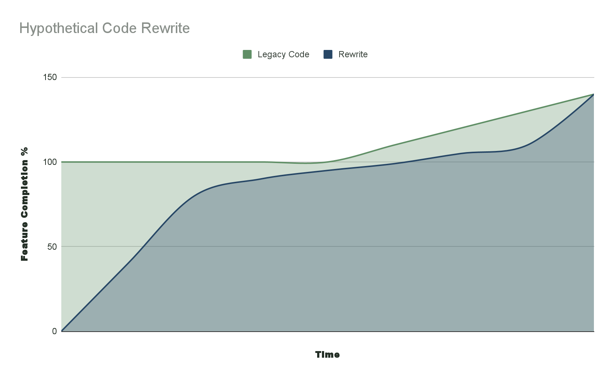
The Grand Redesign in the Sky
Bad Ideas
Pressure to Finish
Notes:
This has been going on for a long time at this point, the developers on the managers are losing patience, product is losing patience, even the redesign team are losing patience
The pressure to finish mounts, corners are cut, and now are brand spanking new module has unclean code, tech debt, and we are right back where we started

Slide 10
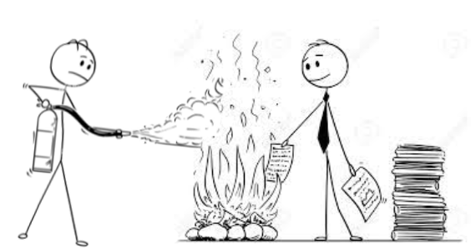
The Grand Redesign in the Sky
Bad Ideas
“Our drugs module is a mess! This code is hopeless, we need to rewrite the whole thing from scratch clean it up”

Slide 11
S.O.L.I.D

Slide 12
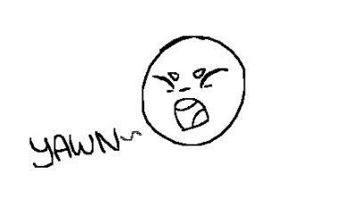
S.O.L.I.D
Tools
S - Single-Responsibility Principle
O - Open-Close Principle
L - Liskov Substitution Principle
I - Interface Segregation Principle
D - Dependency Inversion Principle

Slide 13
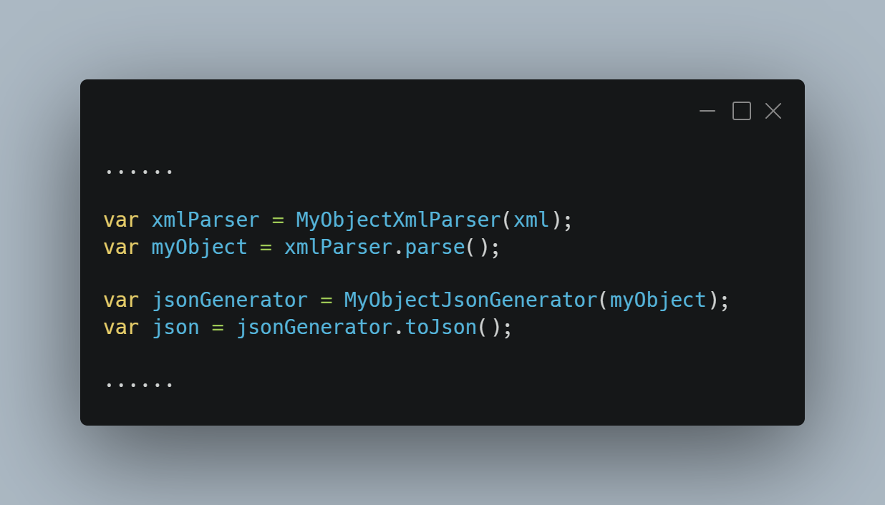
Single Responsibility Principle
Tools - S.O.L.I.D
MyObjectXmlParser has one job, to parse MyObject from XML strings and return that object
Changing it to also generate JSON from that object violates the single responsibility principle
If you need to convert that object to JSON create another class

Slide 14
Single Responsibility Principle
Tools - S.O.L.I.D
Each class should have one job
Therefore if a class needs to be changed, it should have exactly one reason to be changed (or the change creates more then one reason that the class might change in the future)
The result of a change should be that the changed class still has only one job
This same rule applies to modules, functions, structs, and enums
Notes:
Each code module/ class / struct / enum / file should have one job. We’ll use class as an example to elaborate. For a given class, if it needs to be changed, it should have exactly one reason to be changed. The result of the changed class should be a class that still has only one job. So even if the change itself seems fine, if the resulting class can now do more than one job, this principle has been violated

Slide 15
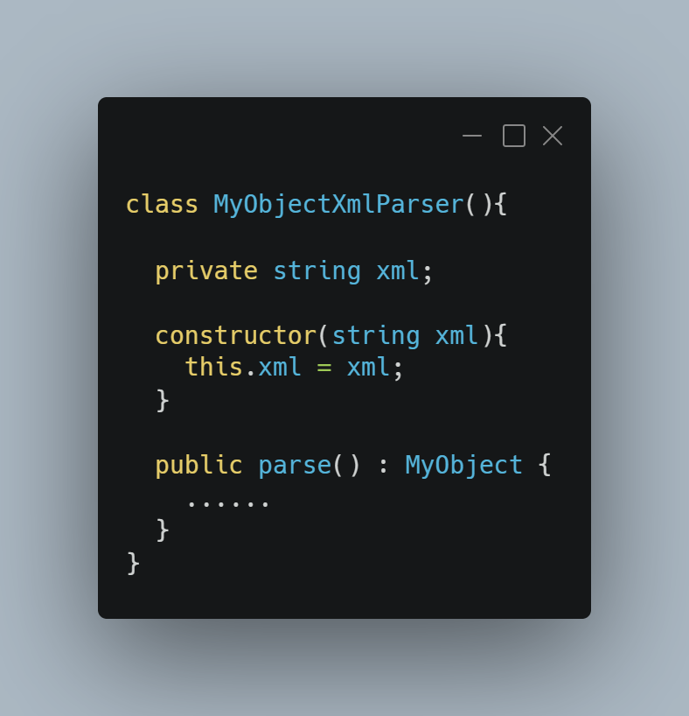
Single Responsibility Principle
Tools - S.O.L.I.D
Consider a class that parses XML
It has one job - parse MyObject from an xml string
Regardless of how long or short the contents of the parse method it does exactly one thing
**Note: we will worry about long/unreadable/crazy methods later

Slide 16
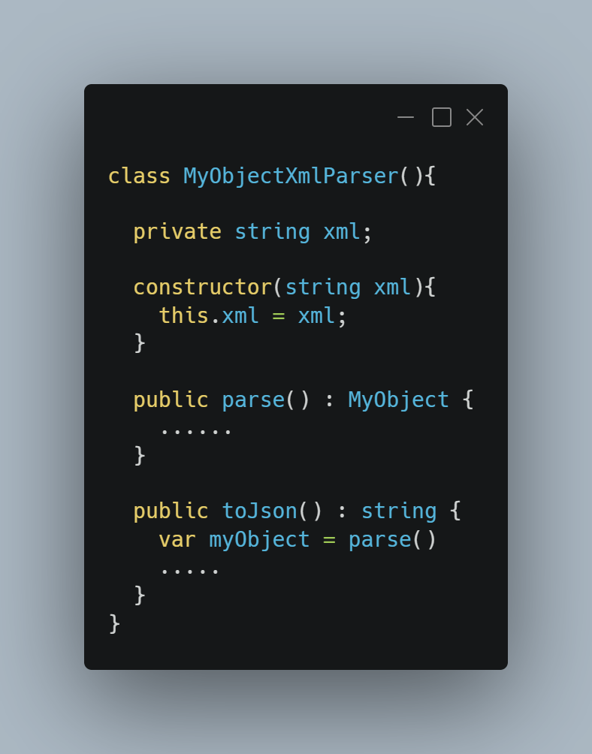
Single Responsibility Principle
Tools - S.O.L.I.D
Now we have a new requirement. Parse MyData xml strings to json
It has one job - parse MyObject from an xml string
It might seem like a good idea, even a good re-use of code to simple
Except now this class can be changed for two reasons: The XML parsing rules can be changed or the JSON output rules can be changed

Slide 17
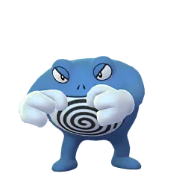
Open-Close Principle
Tools - S.O.L.I.D
Classes should be open for extension but closed for modification
In other words a class should be extendable without needing to change the class itself
This is especially true if other classes or modules use it already
This can be accomplished by using interfaces/ protocols that are substitutable by polymorphism (if you haven’t talked about polymorphism since your last job interview that’s okay, we’ll talk about it a bit more)

Slide 18
Open-Close Principle
Tools - S.O.L.I.D
Does this little class really need an Interface / Protocol?
In short, yes. Whenever possible we want to program against abstractions instead of a concrete implementations.
It also helps us extended the functionality of our code without changing / modifying existing classes
This allows you to not have to think about all future uses cases as you are building your code with extensibility in mind
Let common sense prevail, a object that is purely part of a model whose properties and interfaces match exactly isn’t very useful

Slide 19
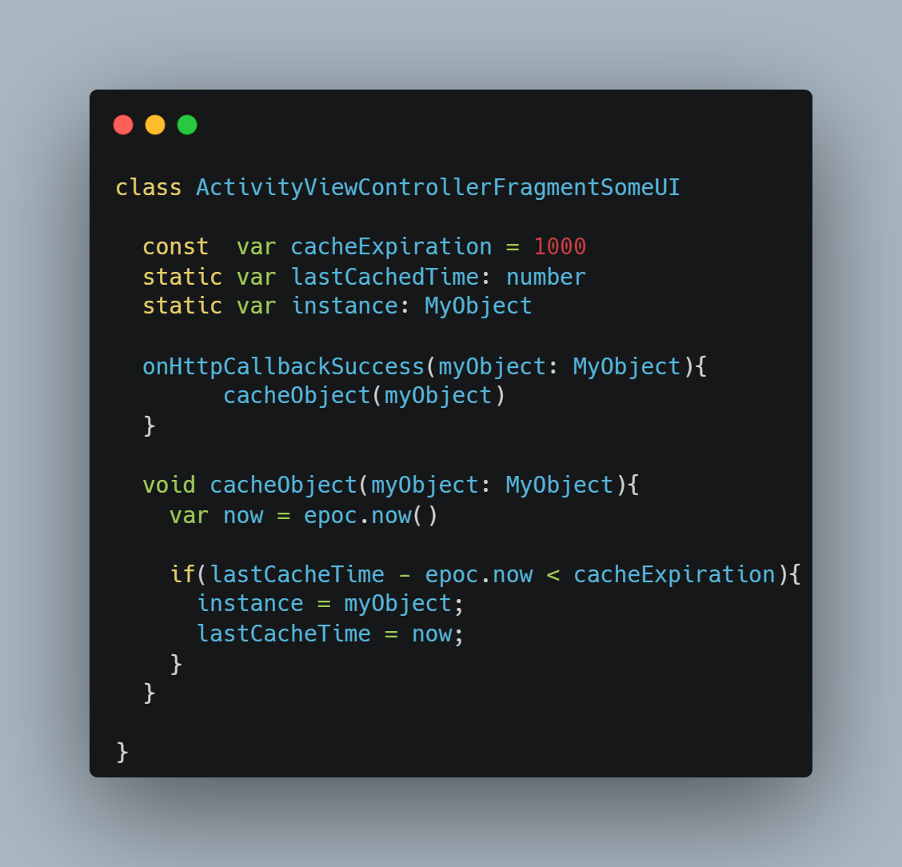
Open-Close Principle
Tools - S.O.L.I.D
This works fine
But how can we make this open to extension but closed to close to modification?
Also now this class will change if we need to change UI behavior or cache behavior. doesn’t this violate the Single Responsibility Principle?

Slide 20
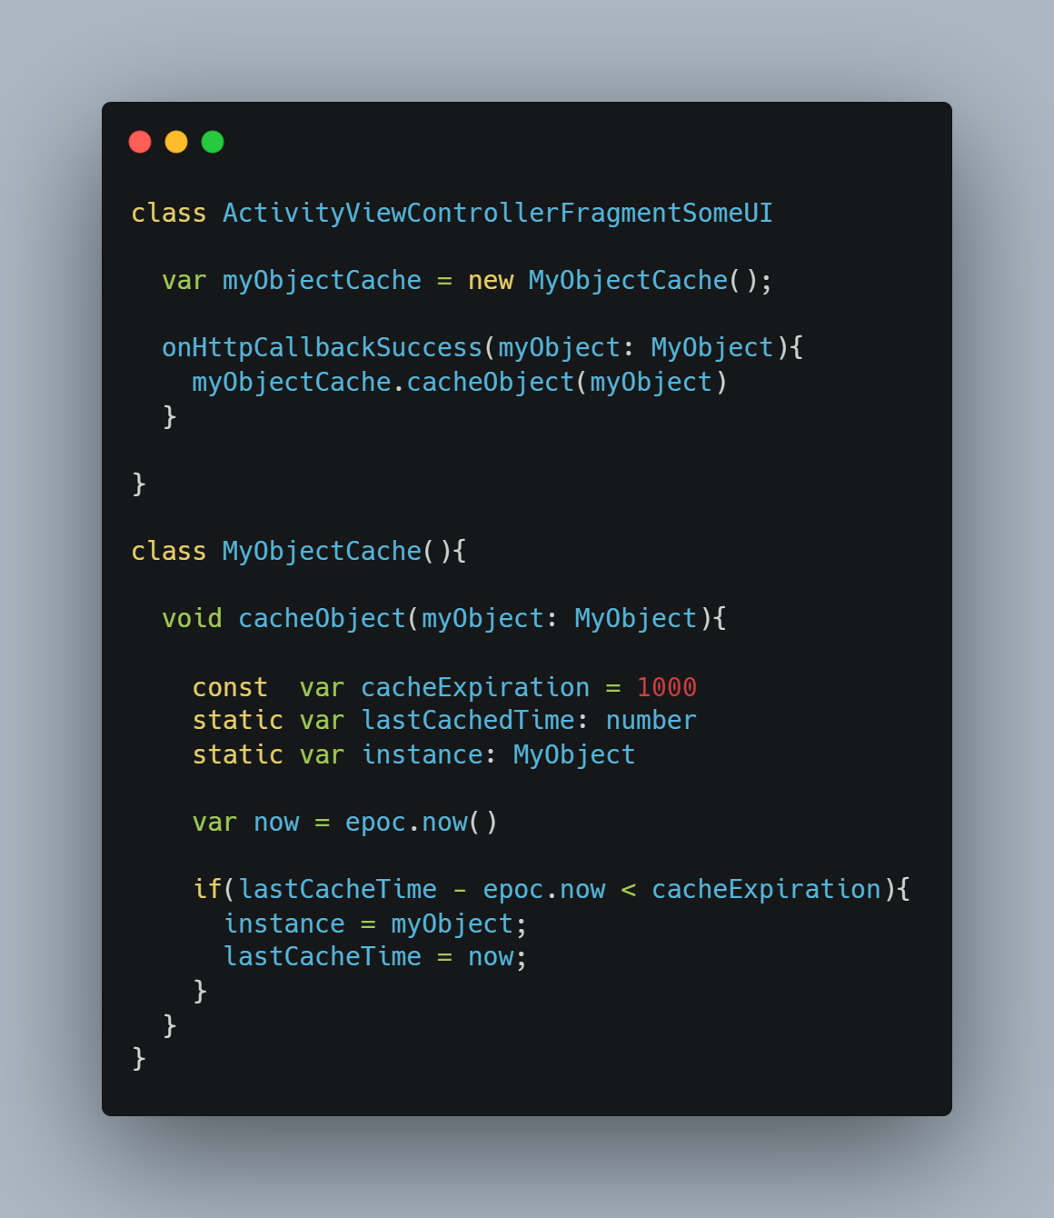
Open-Close Principle
Tools - S.O.L.I.D
Remove the concrete implementation of the caching logic from the UI class
Now we can at least modifying the caching logic without updating the UI class
But the UI class is still open for modification….

Slide 21
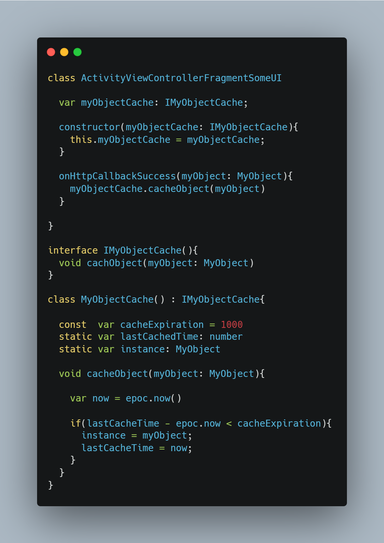
Open-Close Principle
Tools - S.O.L.I.D
Enter new requirements!
We now need the ability to persist the cached data through an app cold start
We could use dependency injection to do this without worrying about the UI class at all by using Interfaces / Protocols

Slide 22
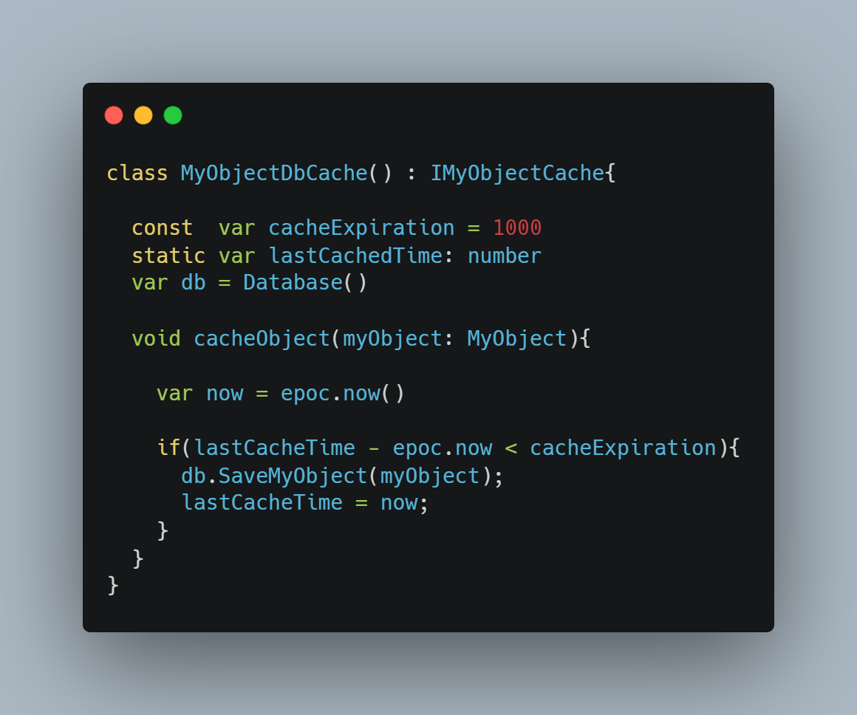
Open-Close Principle
Tools - S.O.L.I.D
Polymorphism!
Create a class that can cache objects in a more permanent manner
Have it subscribe to IMyObjectCache interface/protocol
Notice we don’t even care about the UI class anymore. We can extend the behavior of the UI class without changing a single line of code inside it
Notes:
Gists for all this: https://gist.github.com/palburtus/247d58af1683ca7c14472c397033940d
Not only have we extended the functionality of our UI class but it can be extended again and thus is open to extension. If we wanted to cache object using a different method than a database (we probably do) we can make the UI class change how the caching occurs without modifying the UI class itself
The Open Close principle can get confusing in that it may sounds like your we’re saying your not allowed to change code once you’ve wrote it and it is being used. While that would certainly be nice, it is not very practical. However through the correct use of interfaces and dependency inject, we can modify the behavior of a class without changing a single line of code in the class itself. The goal of this principle is not to never change code again, but to try to code classes with dependency with the ability to extend the behavior without changing the code in mind.

Slide 23
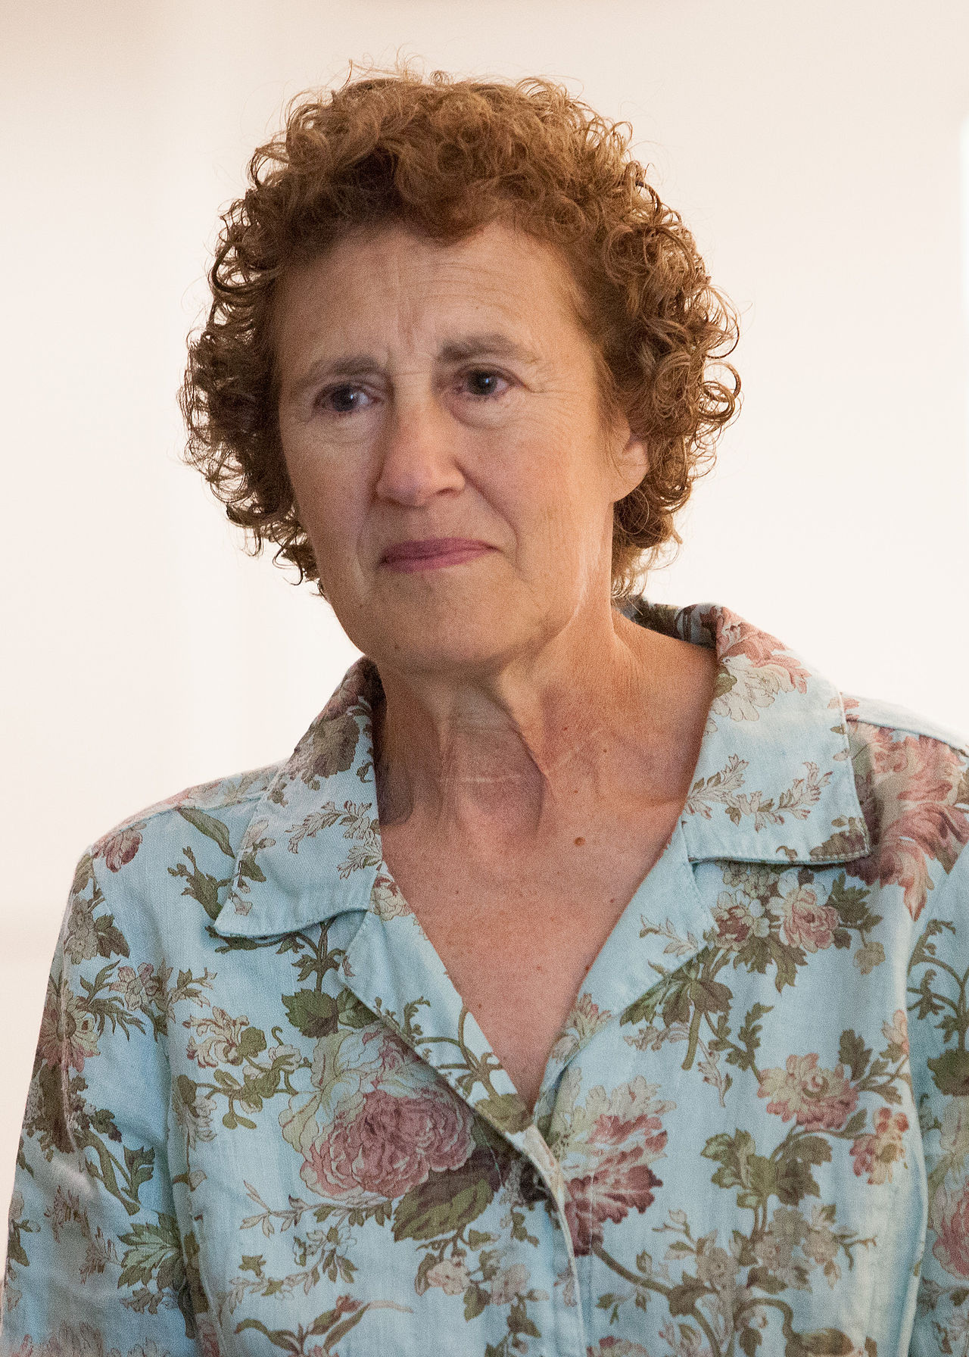
Liskov Substitution Principle
If for each object o1 of type S there is an object o2 of type T, such that for all programs P defined in terms of T, the behavior of P is unchanged when o1 is substituted for o2 then S is a subtype of T…….duh!?
Tools - S.O.L.I.D
Builds off of Open-Close
Helps avoid bad use of abstraction especially inheritance
Its most basic definition is that if we substitute a superclass with any of the subclasses the program should not break
Barbara Liskov
Notes:
In my opinion this principle is more about helping to identify bad uses of abstraction and violations of the open close principle

Slide 24
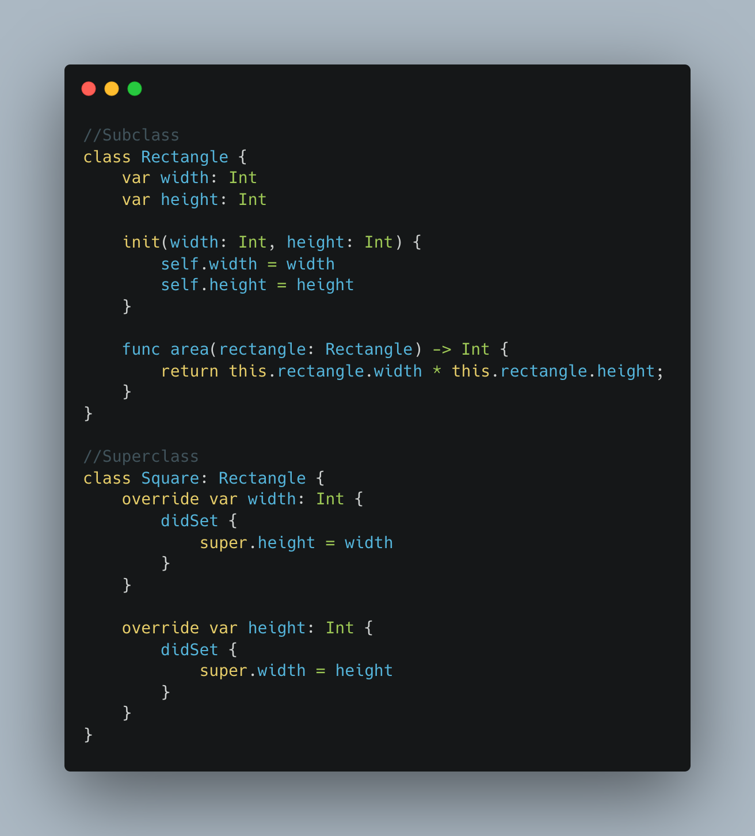
Liskov Substitution Principle
Tools - S.O.L.I.D
What exactly do we mean by the program breaking, it can mean a few different things
One example is unexpected behavior
Consider the most classic example of the LSP
Notes:
I’ve tried my best to avoid using trivial examples in this presentation because I find them unhelpful for learning. However I, like many other people find definition of the LSP a bit tougher to get my head around.
Also it will take more then one example to properly explain this rule so we’ll start small and work our way up.
Shapes are both a common way to introduce new programmers to inheritance and in this case also is considered to be the classic example of violating the LSP and creating unexpected behavior.
Let’s start with a Rectange and a Sqaure. In the literal sense a Square is a type of Rectangle. Seems like a natural situation for inheritance right?

Slide 25
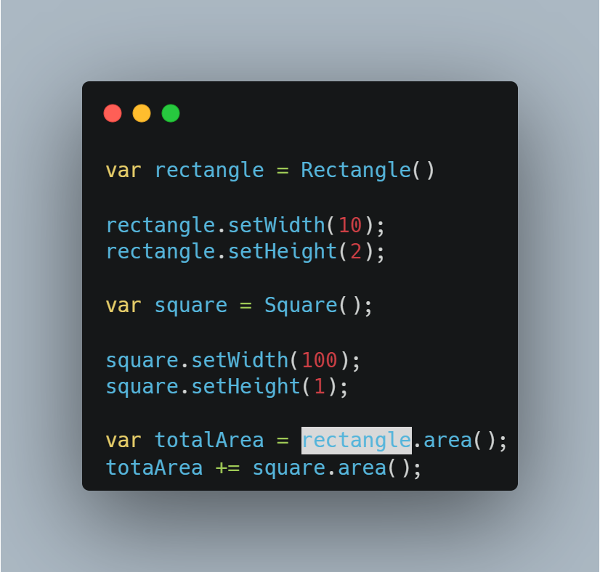
Liskov Substitution Principle
Tools - S.O.L.I.D
Now create a class that calculates rectangle areas and get the area of a rectangle and square
The value of totalArea would turn out to be 21, which is technically (or at least mathematically) correct
But it creates unexpected behavior. We could pass the square to an object expecting a rectangle which wouldn’t expect height to modify width
Notes:
So we’ve got a rectangle and square classes and we want to calculate the area of any rectangle so we build a calculator. When we set the height and width of the rectangle the rectangles height and width change accordingly. However when we do the same to Sqaure, which remember inherits from rectangle setting the width also sets the height and vice versa. While this is technically correct it is confusing. Now most people are familiar with the shapes like Squares so this may seem harmless but imagine this same scenario with a more complicated class? Would we really expect this behavior.

Slide 26
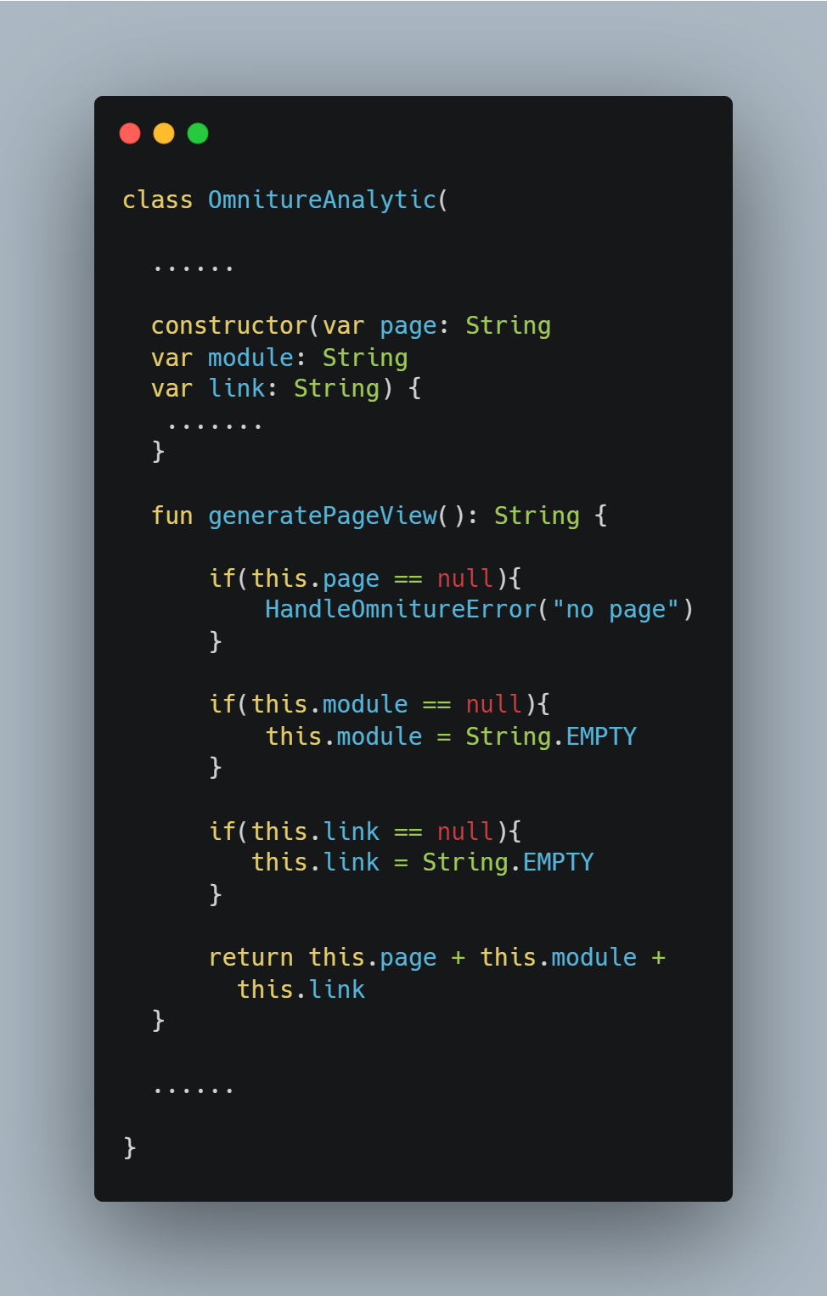
Liskov Substitution Principle
Tools - S.O.L.I.D
Another example of inheritance breaking the program
The subclass’ methods have different validation rules then the superclass
Notes:
Let’s take a slightly more realistic example. Suppose we want to write a simple wrapper to make it easier to send Ominture calls. In this case we would want an exception to get thrown if the “page” value is null
Github gist for these files:

Slide 27
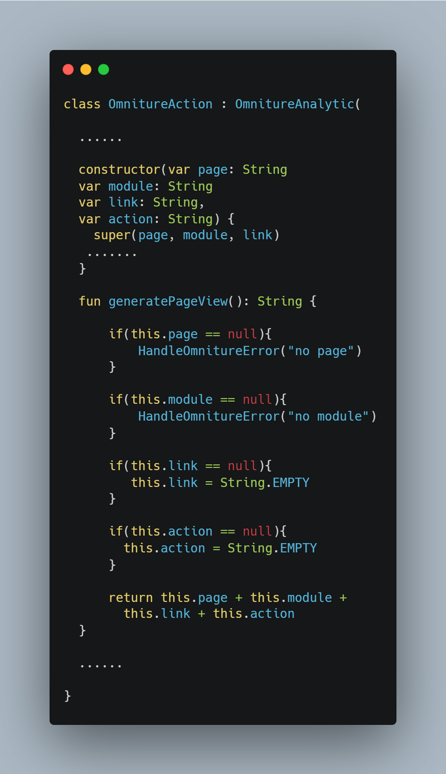
Liskov Substitution Principle
Tools - S.O.L.I.D
Now we are given a new requirement.
Let’s say for the sake of this example an OmintureAction has one additional parameter from Omniture Analytics
Seems like a good place for inheritance
However, in this example the module parameter is required
Notes:
But of course we’re given a new requirement, we need to send action calls as well. For the sake of this example let’s say that the requirement for an action call has only two differences then the OmnitureAnalytic. One is that the analytics has a new parameter called action and that an exception must be thrown if the module parameter is null
Github gist for these files: https://gist.github.com/palburtus/1bc984feffb6bd3f7a0ca5e0637d68c8

Slide 28
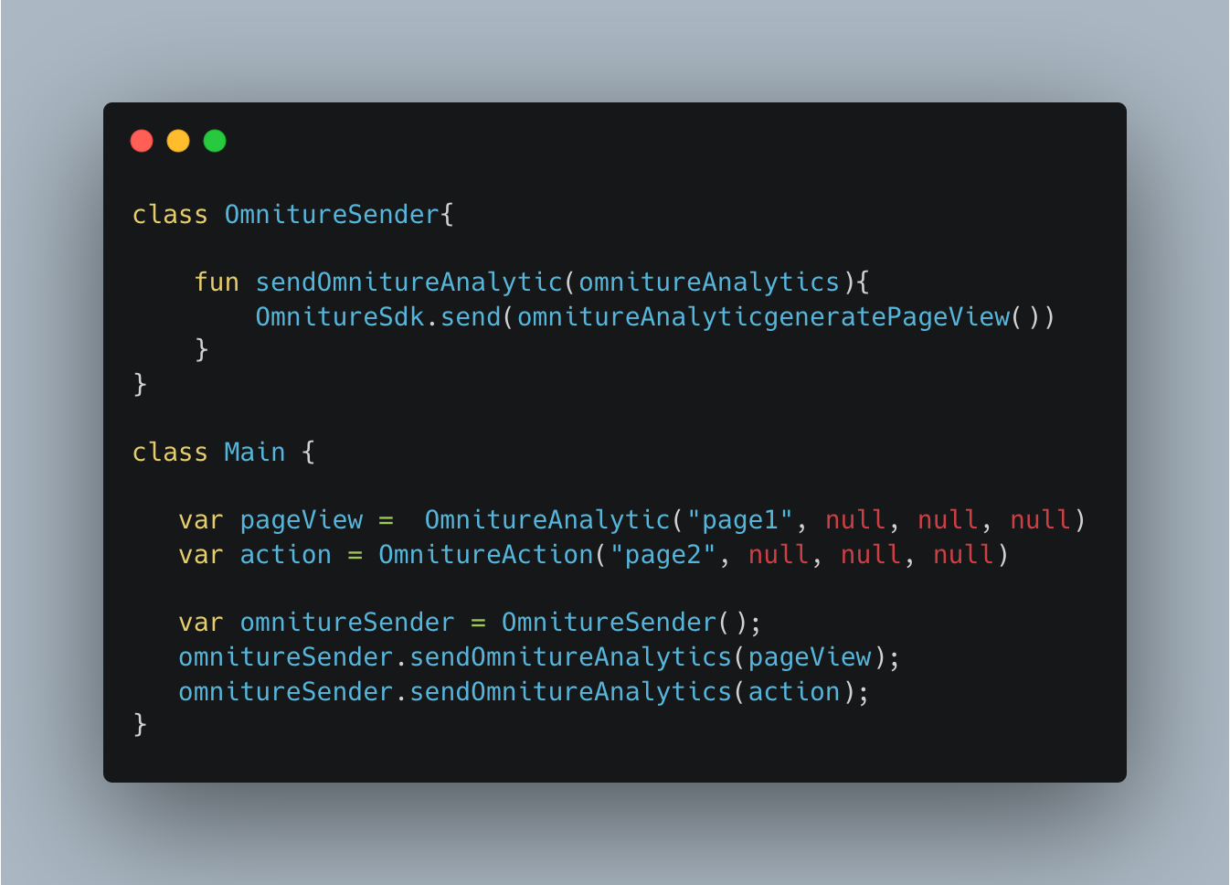
Liskov Substitution Principle
Tools - S.O.L.I.D
The added validation results in unexpected behavior.
Remember, we already have a class that is expecting an object of type OmnitureAnalytic
Most languages will allow you to pass the OmnitureAction via polymorphism
But OmnitureSender has no concept of OmintureAction
Notes:
The addition of extra validation once again results in unexpected behavior, this time in the OmnitureSender class.
Github gist for these files: https://gist.github.com/palburtus/1bc984feffb6bd3f7a0ca5e0637d68c8

Slide 29
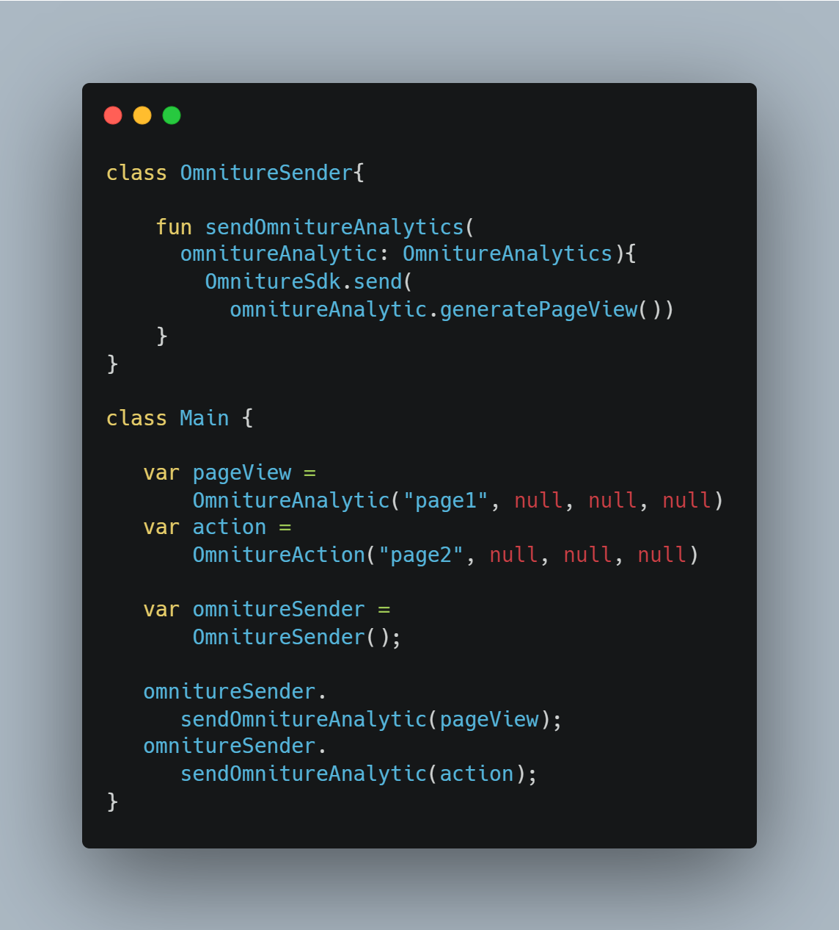
Tools - S.O.L.I.D
Notes:
Even though passing a pageview and action to the omniture sender is allowed in most Object Oriented Programming languages via Polymorphism, the OmnitureSender knows nothing about the OmnitureAnalytic
The addition of extra validation once again results in unexpected behavior, this time in the OmnitureSender class. Even though passing a pageview and action to the omniture sender is allowed in most Object Oriented Programming languages via Polymorphism, the OmnitureSender knows nothing about the OmnitureAnalytic
Github gist for these files: https://gist.github.com/palburtus/fbcd62be607d7699fe9639dd487036d4

Slide 30
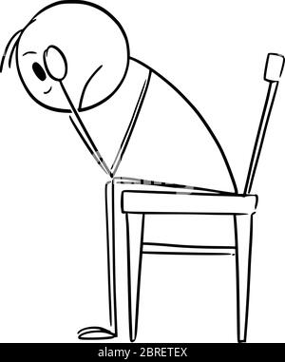
Interface Segregation Principle
Tools - S.O.L.I.D
First this guy says always use interfaces and then he don’t use to much of them
Classes shouldn’t be forced to implement interfaces they won’t use
Writing all of your implementations against one large abstraction will cause implementations of your interfaces to go unused
This creates instances where implementations expect the class behind the abstraction to do something when it in fact ends up doing nothing or worse, throws an exception
Notes:
The Interface Segregation Principle states that clients should not be forced to depend on interfaces they do not use.

Slide 31
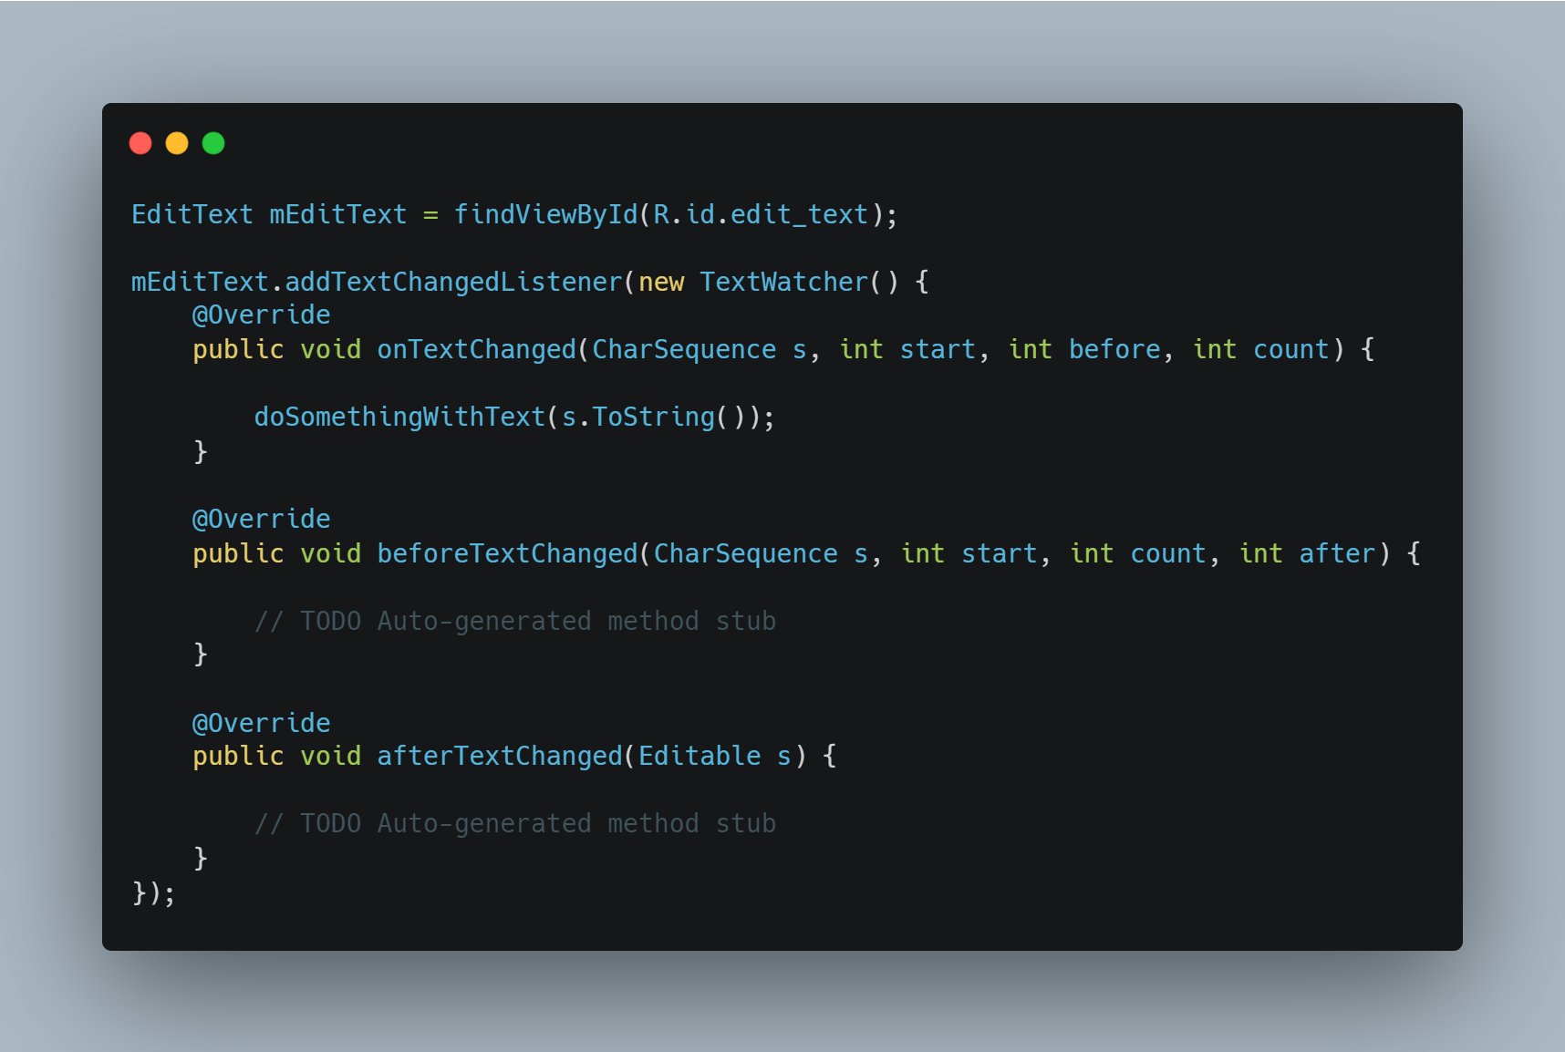
Interface Segregation Principle
Tools - S.O.L.I.D
Keep the scope of interfaces small so that you only use what you need (remember Single Responsibility Principle)
Use abstractions whenever possible but limit their scope.
Consider the following nightmare that long time Android developers are all to familiar with
Notes:
While we want to rely on abstractions whenever possible it is important that you limit the scope of your abstractions. Large interfaces can result in classes they cannot not or will not implement some of that interfaces methods and in the worse case may force you to throw an exception Not Implemented Exception. Here is an example that has driven Android developers nuts for years. We are simply trying to get the input from a Text Box or EditText as the user types. For that primary use case we only need the ‘onTextChanged’ method but Android forces use to implemented beforeTextChanged and afterTextChanged. This causes a few problems, one is confusion, which method should I use, for the standard use case where I just want to capture what the user is typing, why would I want unused ‘beforeTextChange’ and ‘afterTextChange’ implemented and empty every time I just want to get the value of the TextBox when a use is typing

Slide 32
Interface Segregation Principle
Tools - S.O.L.I.D
Break up Large Abstractions into Multiple Abstractions
The Single Responsibility can be a good guide for the scope
Notes:
If you are trying to abstract different things try breaking them up into smaller abstractions instead of one lager abstraction. This ties in closely with the single responsibility principle which can be a good guide when deciding whether you abstractions too specific.

Slide 33
Dependency Inversion Principle
Tools - S.O.L.I.D
High-Level Modules should not import anything from Low-level modules, both should depend on abstractions
Abstractions should not depend on details, details should depend on abstractions
In other words…
Use Interfaces/Protocol to define how your classes interact with each other
Interfaces should not depend on concrete classes
Notes:
Dependency Inversion, when done correctly is one of the most powerful tools in your development “toolbox” Don’t let the definition fool you, this one is not that complicated. In my humble opinion this principle can result in some of the biggest code improvements with the smallest amount of time investment.

Slide 34
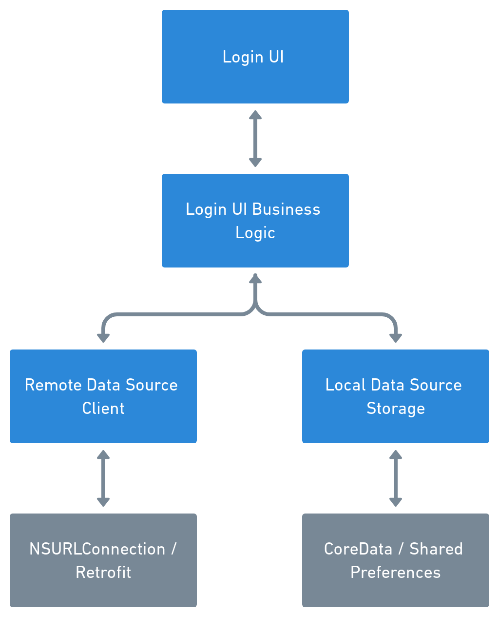
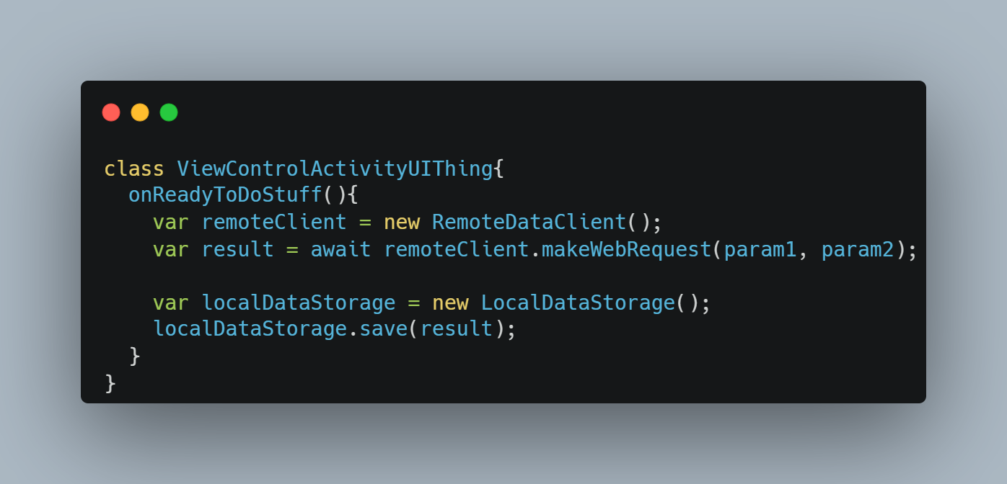
Dependency Inversion Principle
Tools - S.O.L.I.D
Typical Dependency Graph
Notes:
Allows decoupling of classes and makes changes much easier. Let’s mapp out a typical dependency graph, remember this is nothing inherently WRONG with this and it will probably look pretty straight forward to you, that’s okay. Take this example of a very simple app that makes an HTTP request to login a user and in some way save save that data (it could be in memory, more permanent caching, a database, whatever). We have our Login UI (our ViewController/Activity or Fragment). We have a class called by this view model that handles the business logic (What would this be in iOS???/ ViewModel). That class is dependent on two classes, one that fetches the remote data from a server and one that store that local data both of which have their own dependency.
Seems pretty clean right? After all we’ve created separate classes to handle our UI logic and even other classes to separated that logic into logic that makes the remote connection and logic that saves the data locally. These both in-turn call some 1st or 3rd party library to accomplish this data. This code might look roughly like what is depicted above. So what’s the problem?

Slide 35
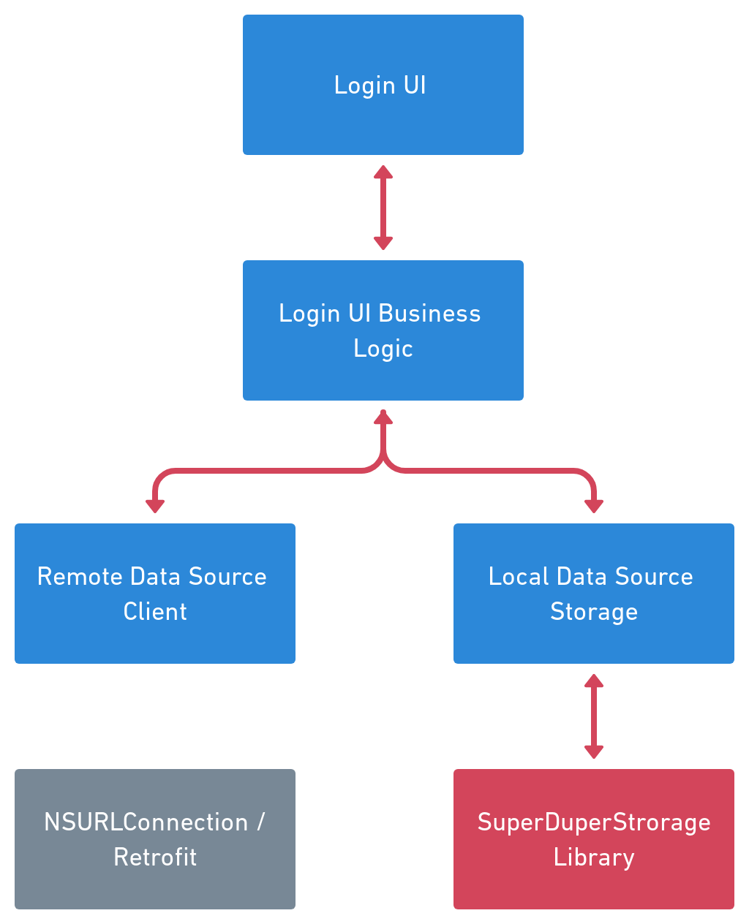
Dependency Inversion Principle
Tools - S.O.L.I.D
Now, Inevitable Something Changes
Perhaps CoreData / SharedPreferences is not enough we need to save this “better”!
This has the example to affect everything in the dependency tree
Notes:
Now Suppose the Inevitable happens and we need to change something. Let’s say for the sake of this example, Core/Data / SharedPreferences are no longer acceptable. We need to save this information in a remote repository and it’s gonna be great. Your entire application relies on this dependency and now we have to re-test it to make sure it works, we have to update unit and UI tests, we have to change method signatures.

Slide 36
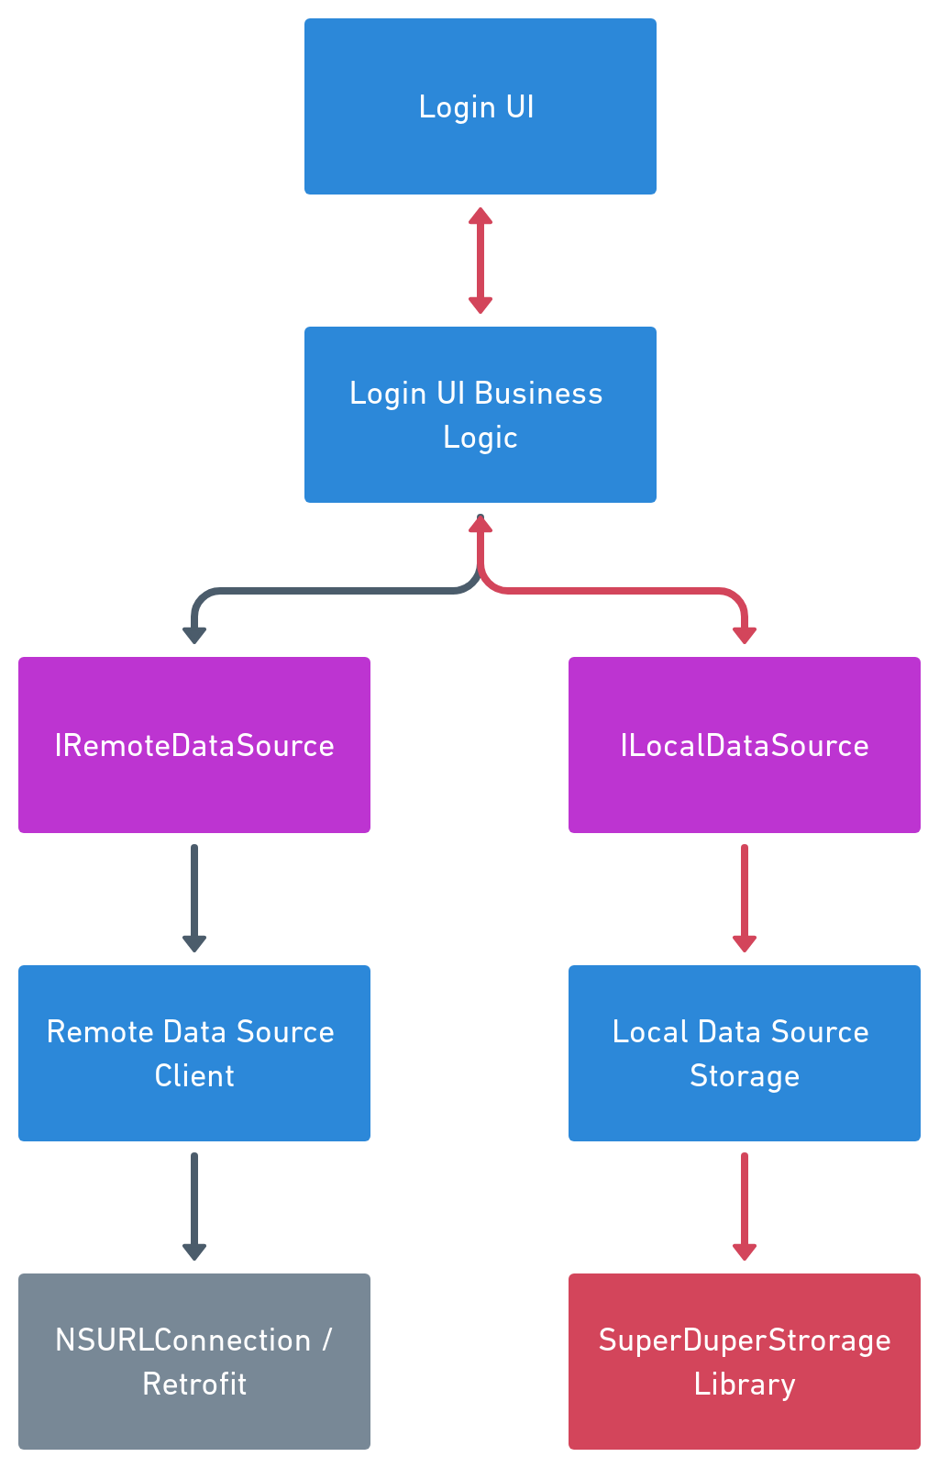
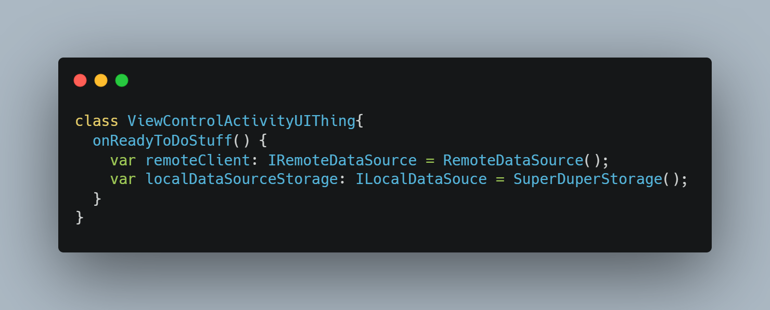
Dependency Inversion Principle
Tools - S.O.L.I.D
What if we used, you guessed it interfaces
This helped a lot…. Can we do better?
Notes:
This is a lot better, we can easily substitute our old implementations with new implementations and preserve the data contract between the local data source and the UI. But why should the UI classes still depend on, much less even know about the the implementations of IRemoteDateSource and ILocalDataSource, there is a better way.

Slide 37
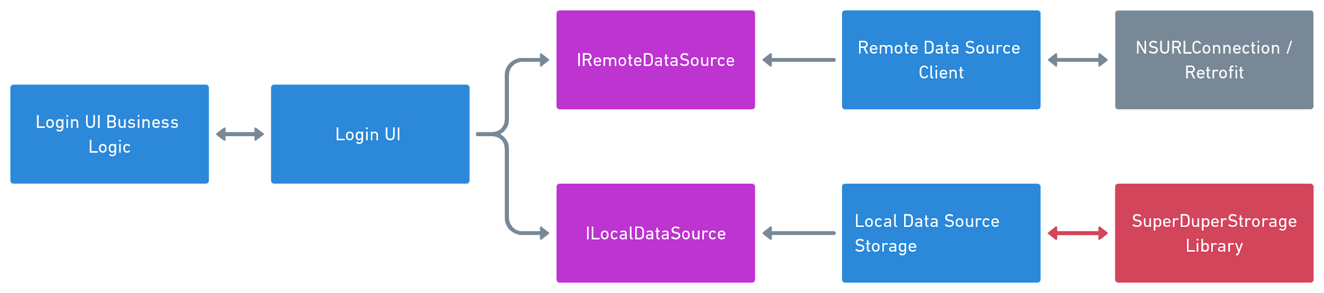
Dependency Inversion Principle
Tools - S.O.L.I.D
We can define our protocols/interfaces based on how our class will interact with each other
Notes:
Notice in this case the Login UI only knows about the two protocols/interfaces. It has no knowledge of how those abstractions are implemented nor does it care, it knows what data contract to handle. Likewise our LocalDataSourceStorage class has no concept of what our UI is or that it even exists. We’ve managed to completely decouple the implementation of our UI from our Data business logic. But how exactly did we do this?

Slide 38
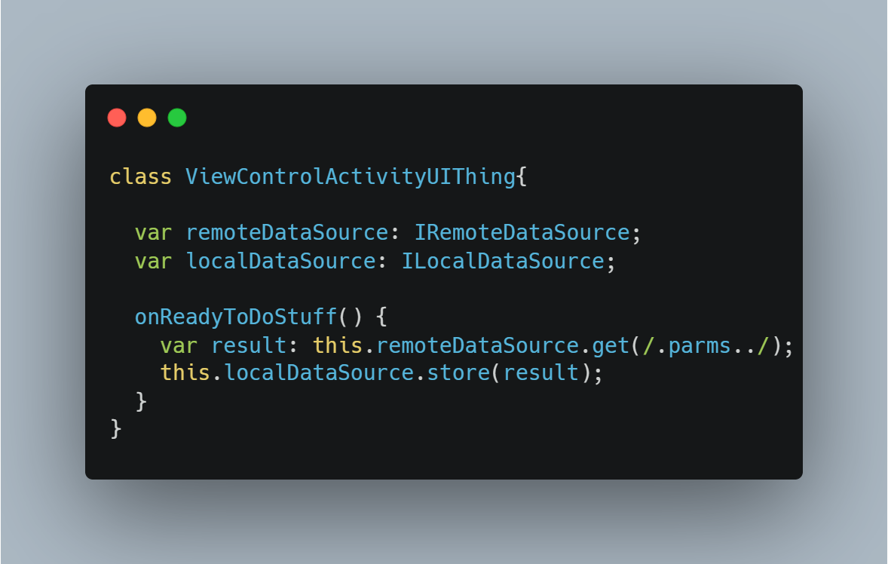
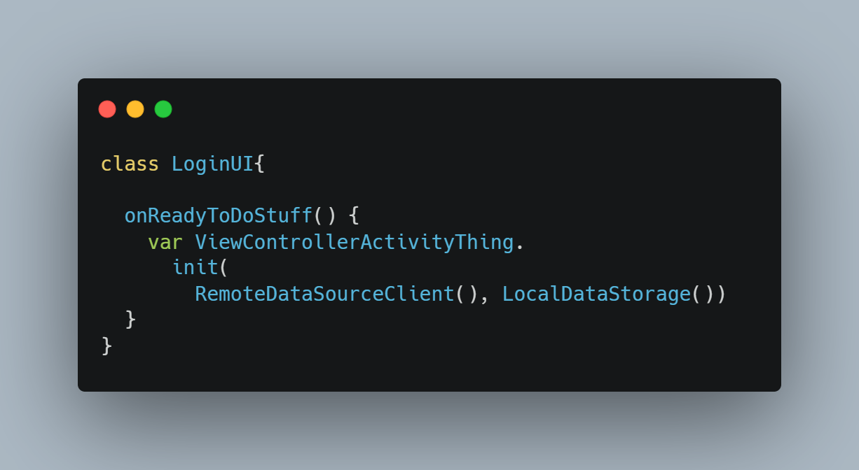
Dependency Inversion Principle
Tools - S.O.L.I.D
How is this accomplished?
Usually using 3rd-party tools, but in its simplest form by limiting initialization
Notes:
There are lots of tools for both iOS and Android Rx and Dagger come to mind that allow you to accomplish this. They are often given as examples if you look up dependency injection in iOS and Android and no doubt have plenty of web pages hailing their virtues. But let’s leave them out of this for now. We don’t need them to accomplish dependency inversion so let’s understand what how we can do this without 3rd parties.
Now in real-life, you might want to define the concrete version of your protocols/ interfaces even higher, perhaps an application level class that way you don’ to specify the concrete implementation throughout your application and you can change on implementation and change the entire app without having to worry about breaking everything because your app has been built against abstractions not implementations!
An important thing to keep in mind here is that this is less about refactoring existing code to minimize dependencies. It is about writing code with abstractions in mind in the first place. It takes time to do this instinctively and practice to do it right.

Slide 39
Principles not Laws
Tools - S.O.L.I.D
I consider S.O.L.I.D. principles a good tool to understand to help your write better code.
I do NOT however consider them un-violatable laws of the universe
Remember they are suppose to make your code more understandable, flexible, and maintainable
Over-Engineered code can be just as much of a nightmare as code with single variable names, ten deep nested if statements, and other similar lunacy
Notes:
S.O.L.I.D is not the be all end all of writing better code. In fact there are smart people who disagree with some of these principles. However, for the most part when it comes to object oriented programming, keeping in one of them in mind while writing your code with improve your code. Learning how they each principle builds on each other and work together can really unlock the potential to make your code easier to read, modify, change, etc.
It is important to realize that this are guidelines, not laws. If you find yourself bending over backwards to fit your code to meet S.O.L.I.D principles, chances are you either doing it wrong or even just overthinking it. Remember they won’t solve every problem, but when used consistently they can improve your application.
They are not the only tools that help you write more robust code either.

Slide 40
Clean Code

Slide 41
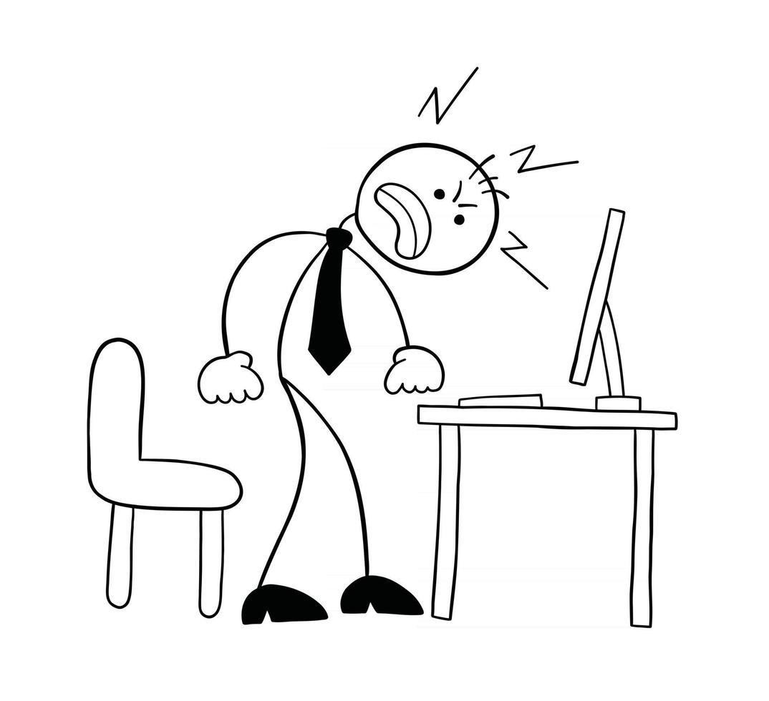
When we make a mess we clean it up
Code Cleanup
WHO THE HELL WROTE THIS CRAP!???
It was a group effort to make this code a mess
It will take a group effort to clean it up.
Notes:
We’ve all made messes, we should hold ourselves responsible to clean it up. Sometimes that means you clean up someone else’s mess, maybe that person doesn’t work here, maybe that person has to clean up another mess.

Slide 42

When we make a mess we clean it up
Code Cleanup
You may find yourself cleaning up someone else’s mess
Chances are someone has cleaned up a mess you made
/// 2016-06-19
/// written by: Pat
class MedMess {
Notes:
Chance are you’ve made a mess at some point in time that was cleaned up by someone else… unless of course it is still a mess.

Slide 43
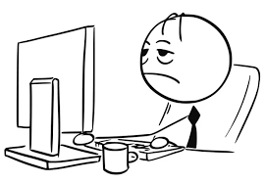
When someone makes a mess we clean it up
Code Cleanup
……..
Then again sometimes it was your mess all along
Either way it is okay
It’s about improving not blaming
Notes:
It is not about blame

Slide 44
Cleaning up Code
Clean Code
How does one clean code
A little bit of a time

Slide 45
Letting the code speak for itself
Clean Code
If a line of code needs a comment to explain what it is doing, you’re probably doing it wrong. (public apis are different explain)
Clean code should resemble well written prose
After all what is the best coding language in the world???
English

Slide 46
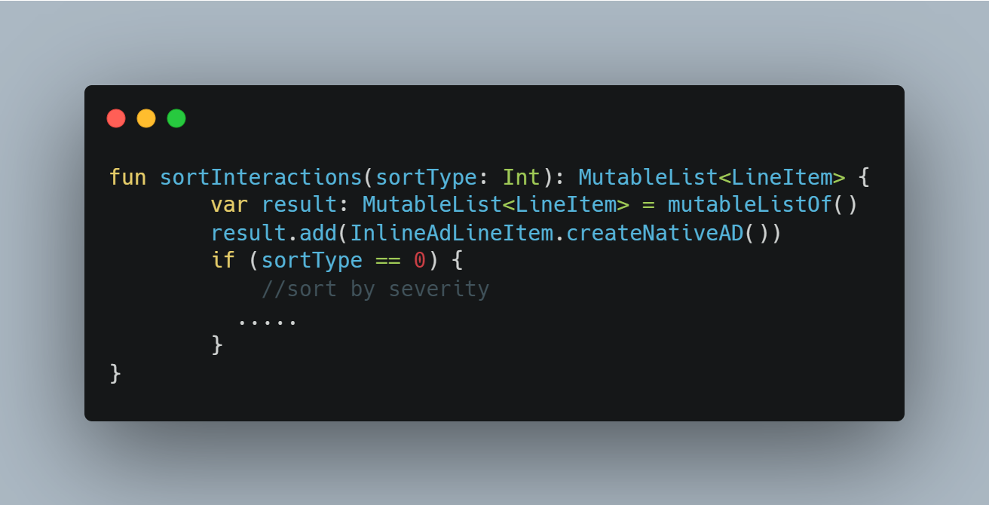
Code Resembles Well Written Prose
Clean Code
Wrapping if statements in private functions

Slide 47
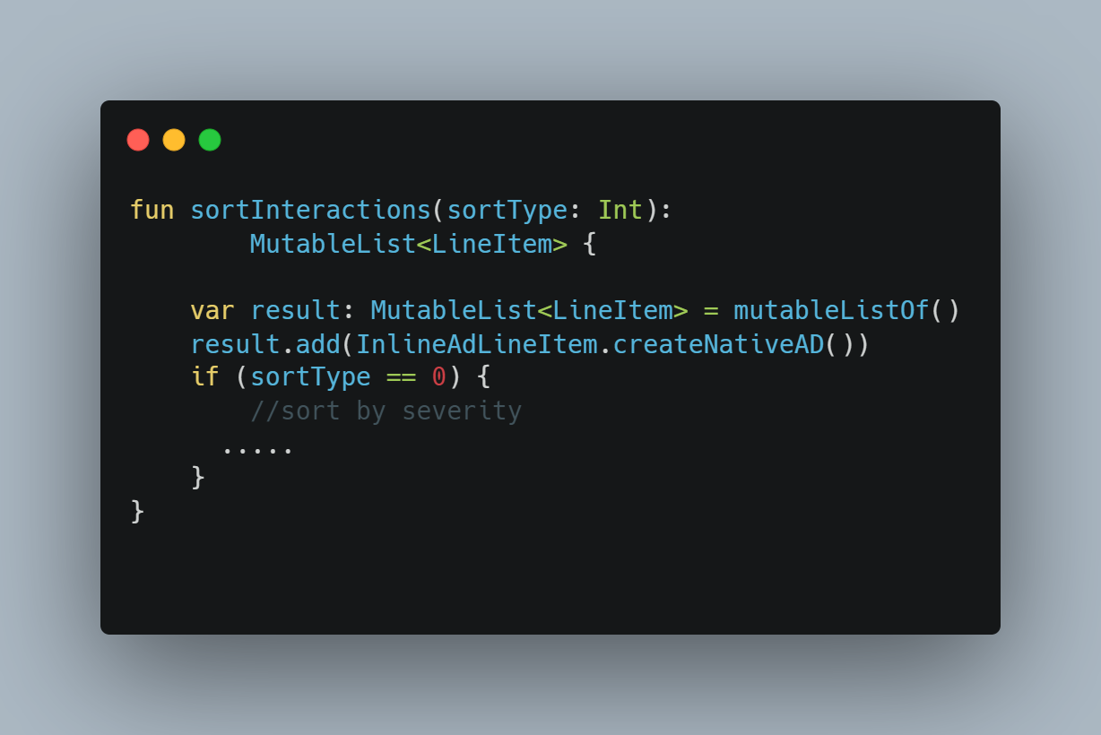
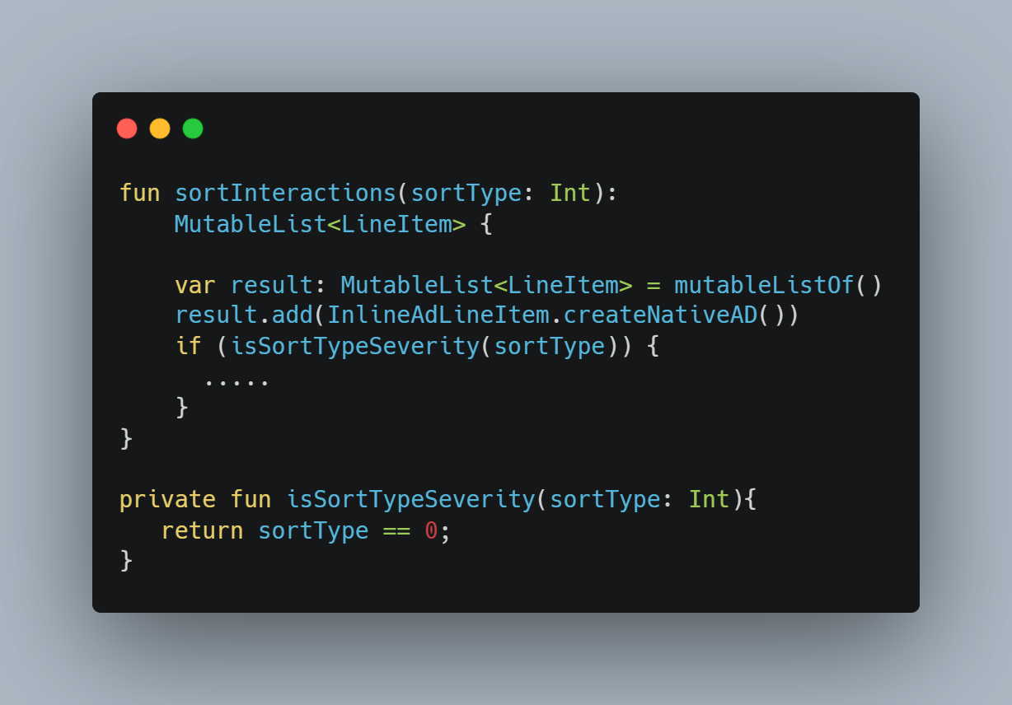
Code Resembles Well Written Prose
Clean Code
Wrapping if statements in private functions

Slide 48
Avoiding Code Smells
Clean Code
Code that indicates a deeper problem
Often Subjective
Not necessarily even a bug
Some examples….
Notes:
The next few slides are focused on things that are generally known as “Code Smells”. A code smell is a characteristic of some code that indicates there is probably a deeper problem. This list is far from comprehensive and creating such a list would be beyond the scope of this. It should also be kept in mind that defining a code smell is subjective, so yet again this is less of a rule book but instead a guide to help avoid and identify problems

Slide 49
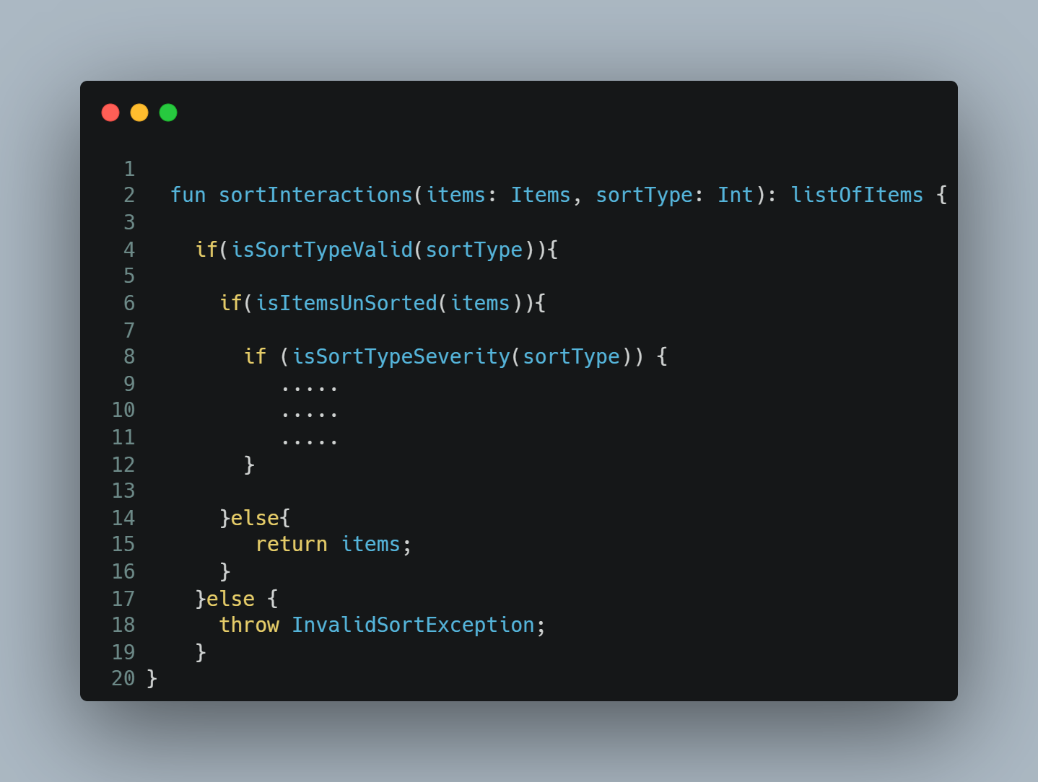
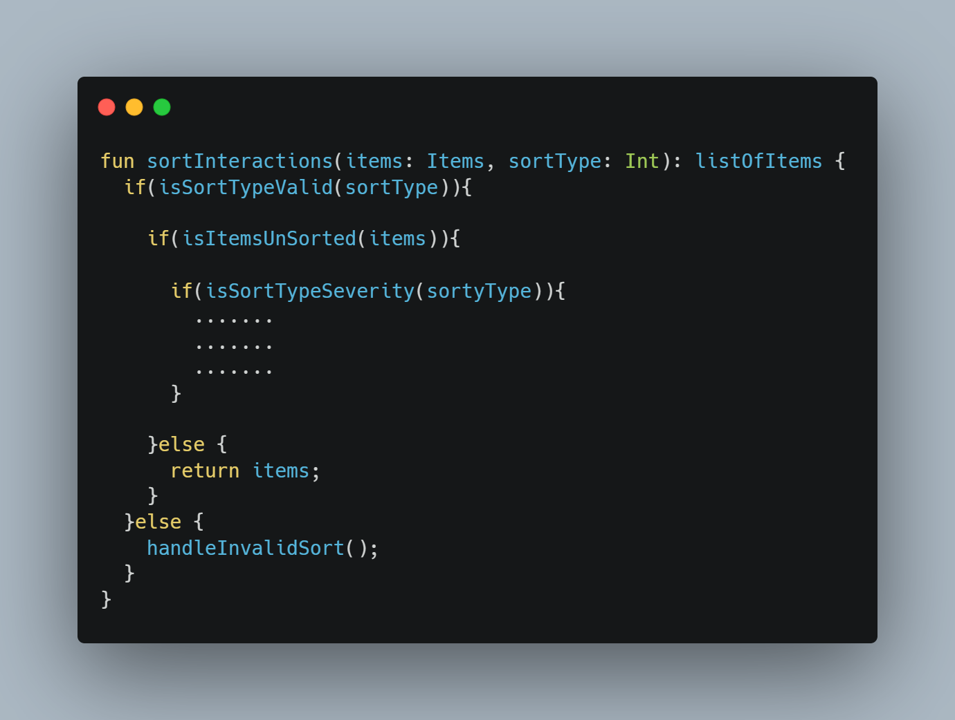
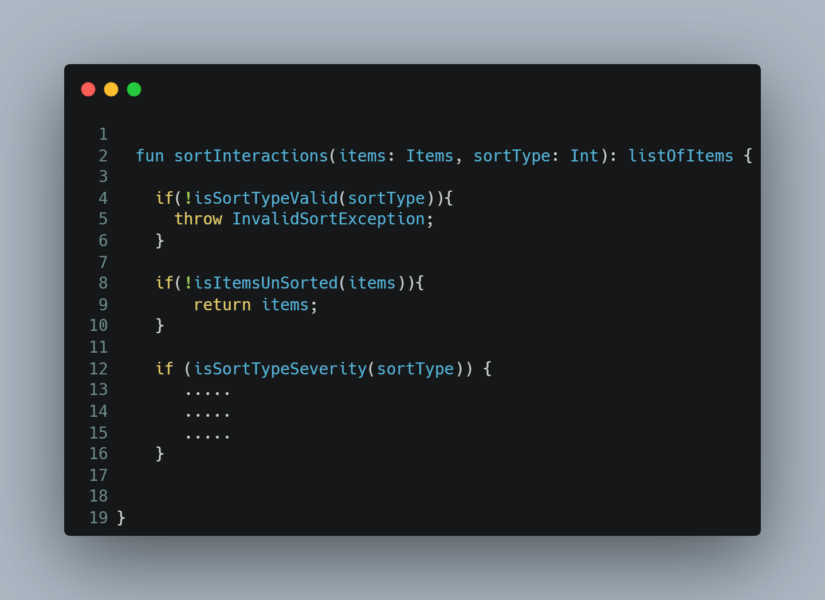
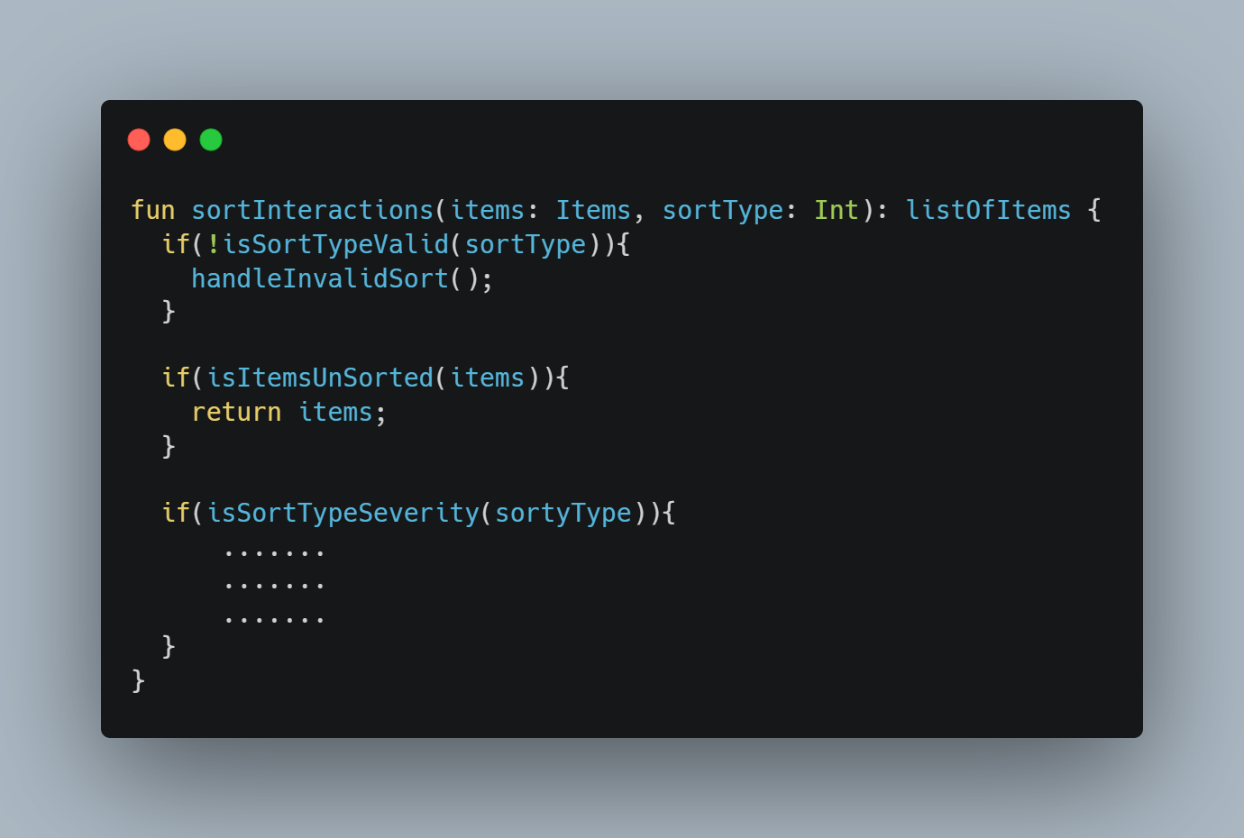
Inverting if statements
Clean Code
Notes:
There are some simple tricks, some of which you may already be doing. You’ve might have heard this one before, maybe your IDE even told you to do it. Consider a function similar to the previous sort function except this example requires some validation. First we check if the sort type is valid and throw and exception if not, then we check if the items are already sorted (for this example let’s assume have an inexpensive way to do this). Simply inverting your if statements can reduce code nesting and increase readability. It also can simplify your logic

Slide 50
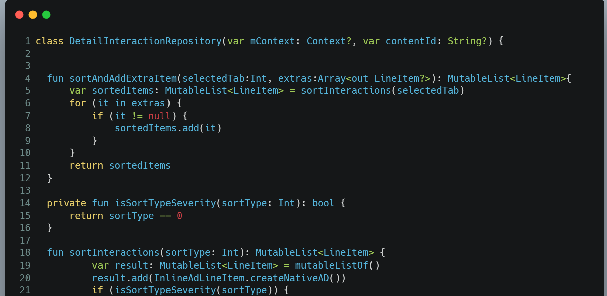
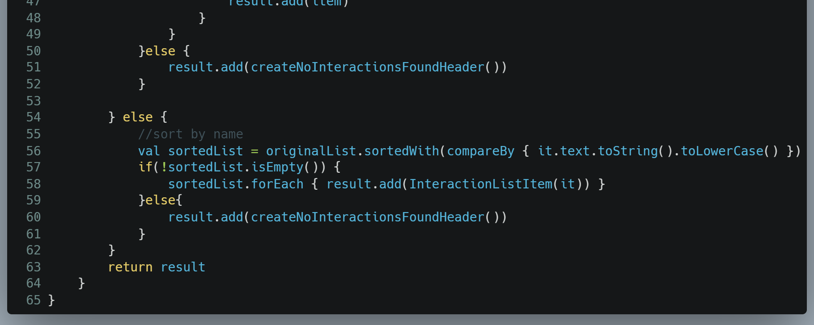
Large methods… Where classes go to hide
Clean Code
Large methods may risk doing too much and are often good candidates for a refactor
Notes:
Take this class as an example. It’s primary purpose it so make a database request on a separate thread and return the results via callback. But it has all of this sorting logic, and has a very large method that sorts and inserts headers into the list of items read from the database. They are not even considered bugs.
Public Gist for this class: https://gist.github.com/palburtus/9d3451b7310ebe6b9f1ac662cf4464c3

Slide 51
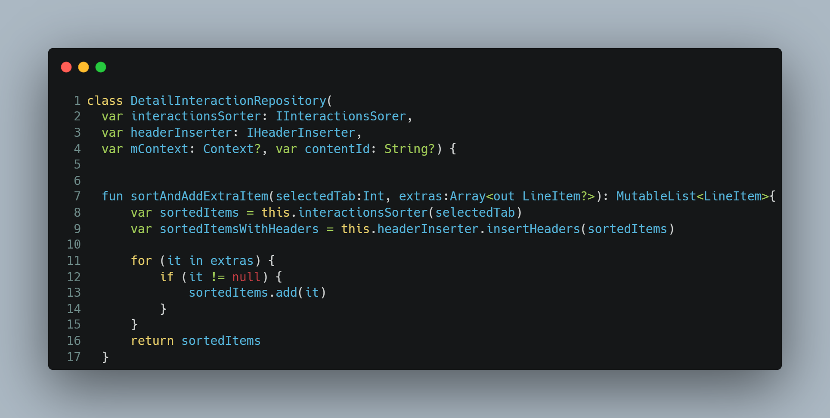
Large methods… Where classes go to hide
Clean Code
Large methods may risk doing too much and are often good candidates for a refactor
Notes:
What if not only created separate classes for the sorting and header insertion but also abstracted them out of this repository using interfaces and dependency injection. Not only does it decouple the sorting logic from the repository logic but it also allows us to split the large sort method into a sort class. We can split that large method up by extracting private methods from parts of the logic. This allows us to also write unit tests for the sorting without relying on the database context.

Slide 52
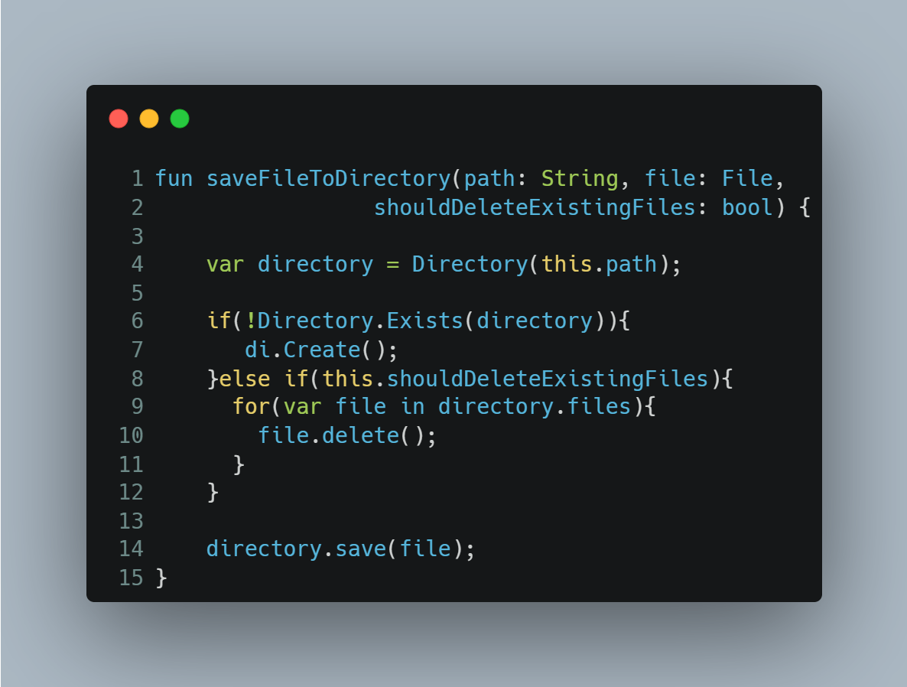
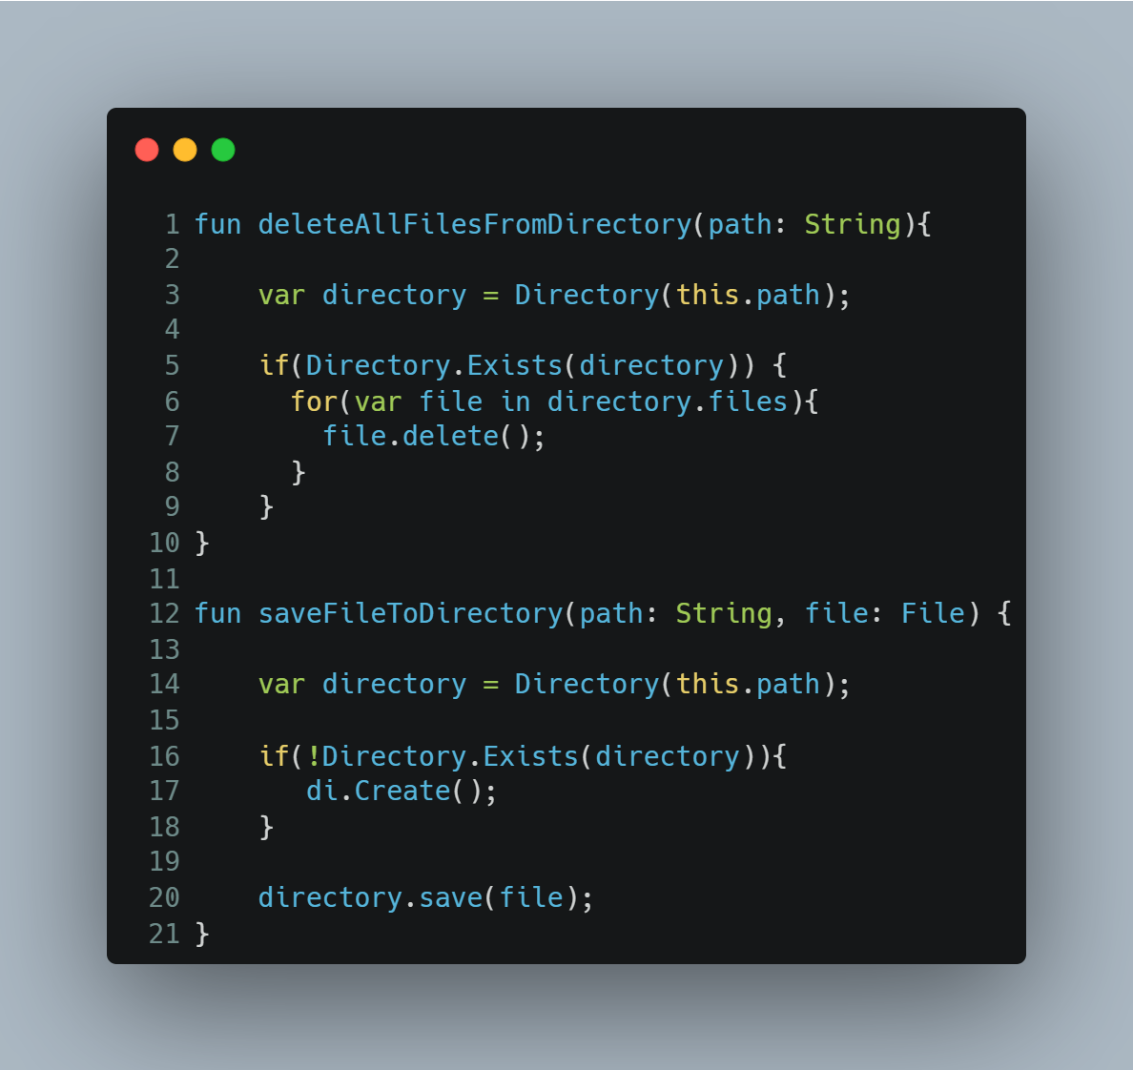
Passing Flags as Parameters
Clean Code
Notes:
https://softwareengineering.stackexchange.com/questions/147977/is-it-wrong-to-use-a-boolean-parameter-to-determine-behavior
Consider this simple real-life example of code I wrote. I added the deleteExistingFiles flag to the method signature for convenience. It might seem pretty straightforward but it, by definition, alters the function to do an entirely separate task that it is designed to.
It doesn’t seem like a big deal here, but should this class be modified, extended, or made more complex I’ve essentially created two different functions side one

Slide 53
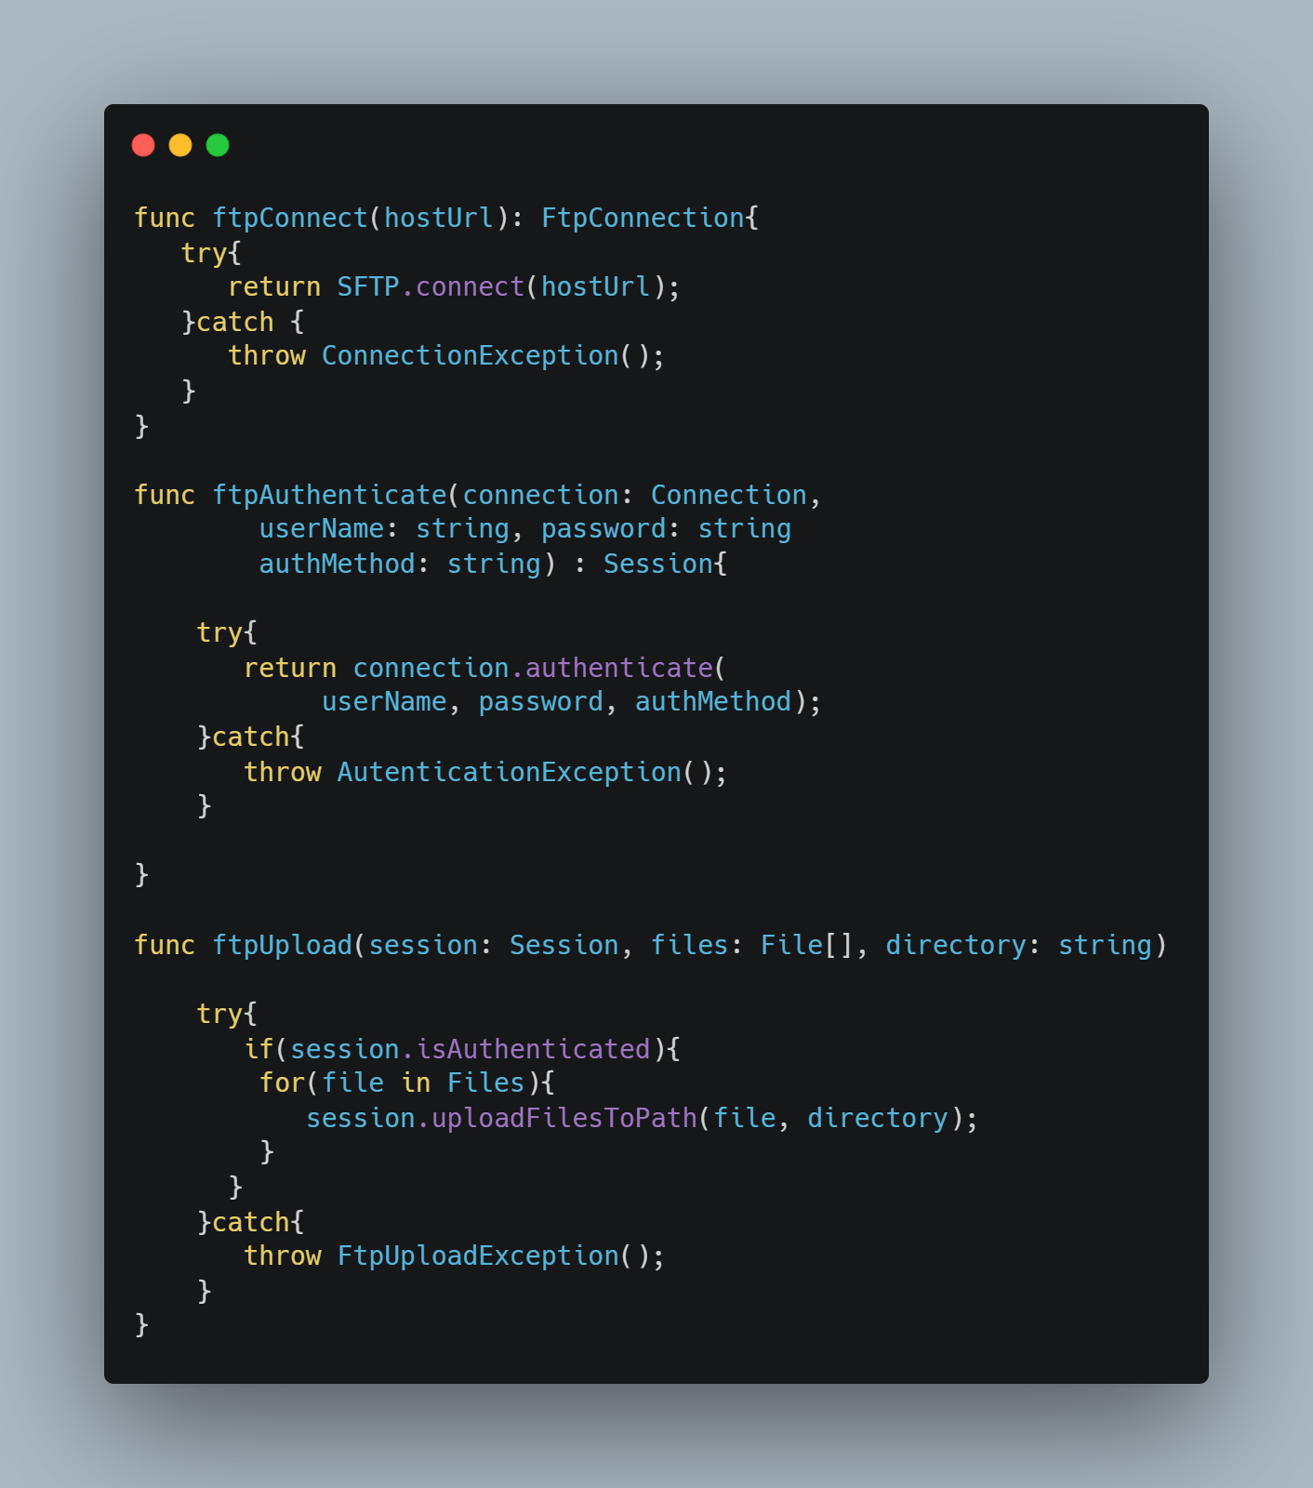

Functions with Too Many Parameters
Clean Code
Notes:
There is not a hard and fast rule of how many parameters is too many. Think of it more as a warning sign that your method may be doing too much. It might need to be split into multiple functions. There might be a object that you missing. Sometimes the parameters themselves are that object. Consider this function I wrote that uploads files to an FTP server using a 3rd-party library SFTP. Hopefully by now you can see that we have violated the single-responsibility-principle
Now we’ve just turned one function into 3. 3 related functions that handle the operations you need for FTPing files. This could be a hidden class of its own.

Slide 54

Functions with Too Many Parameters
Clean Code
Notes:
We can also take related parameters and group them into objects when it makes sense. If the FTP client is always going to need a userName and password and is always going to ask for both of them whenever it needs to connect, there this is good (if much more simple) example of a hidden class

Slide 55
Making private functions public so another class can use them
Clean Code

Slide 56
Clean Code Architecture
Clean Code
TODO:
This slide can easily be a whole other presentation but I want to at least introduce the idea without getting into it.
This also means we should probably agree on what architectures to propose for iOS and Android

Slide 57
Clean Code
TODO more code clean up strategies ………

Slide 58
Leave The Code A Little Better Than you Found It
Clean Code
You will not have time to spend hours refactoring each class you touch
However, if you read or modify a class take some time to improve it
It does not matter if it is a class you wrote or someone else wrote
…and you don’t take it personally if someone refactors your code
Notes:
While this is not meant to suggest that we should never spend dedicated time refactoring code,
If every team member made even one improvement to a class each time they read or modified it, and the entire team has agreed on a guidelines for code cleanup, you don’t have to spend hours and hours refactoring code.
These little improvements have a way of adding up. Not cleaning up code because you didn’t write it is no excuse. If someone submits a refactor of code you wrote don’t take it personally. If you disagree with the change have a conversation
And come to a mutual understanding.

Slide 59
Over Engineering: When keeping it Clean Code goes wrong
Clean Code
Considered this actual code from WebMD Android
Notes:
WebMD Consumer had a great example in the classes that manage the parameters and urls for the business logic behind the environment switcher. I’m going to show some examples and talk about why they are over-engineered and (hopefully) ideas to fix them

Slide 60
Don’t Add to the Mess
Clean Code
Scope new work appropriately
If it is going to take you longer to write clean code, let the time reflect in your story points
Rushing to meet deadlines is an excuse that easily turns into a habit
It is your manager’s responsibility to manage product’s expectations. It is your responsibility to communicate with your manager
Notes:
None of this works if any member of the team is going to add to the mess. It is your manager or lead’s responsibility to manage product’s expectations on how long it will take to get things done. It is your responsibility however, to communicate to your manager or lead if you feel pressured and think you won’t have enough time to finish unless you rush

Slide 61
Testing

Slide 62
Why is Pat so obnoxious about unit tests?
Testing
Does any of this sound familiar?
Your application has an old module, it is very stable, and does it’s job well. It is relatively bug free. The idea of changing it is scary
Your application has a module that is very buggy. It seems like everytime you fix one bug a new seemingly unrelated bug pops up
The unit tests are either non-existent, difficult to write, not passing, or not thorough enough to give you confidence that passing tests equal bug free code.

Slide 63
If it is so great why doesn’t everyone do it all the time?
Testing
This isn’t how most people learn how to write code
Can feel counter-intuitive
Increases upfront development time substantially
Requires much more discipline to do consistently
Well tested applications often require more unit test code then production code
Only really works when the entire team does it
When you are trying to meet deadlines it is the easiest thing to drop from your development (after all, code does not need unit tests to be released)
I can get around to writing unit tests later…

Slide 64
Enter Test Driven Development (TDD)
Testing - TDD
Increases test coverage by its nature
Forces the developer to write code in a testable manner
Allows developers to make changes to code with greater confidence
Reduces bugs in production

Slide 65

The Basics
Testing - TDD
Notes:
Development should be a constant cycle, Red - write a failing test or having your code in a state that it does not compile, Green - write the simplest code to make that test pass, Refactor - look at both your test and production code and refactor wherever possible while still keeping the code green.

Slide 66
Write a Failing Test First
Testing - TDD
Seriously! Please for the love of God if you listen to only one thing, listen to this!
Notes:
Always write a failing test first. If you do everything else wrong and get this write, your code will be better. If you are new to TDD this will feel trivial and even at some times stupid and a waste of time. I assure you it is not.

Slide 67



Write a Failing Test First
Testing - TDD
Notes:
Let’s take our example from before where we want to fetch data from a remote data source and store it locally. First pick the simplest use case first and write a test for it, the code will be read because it won’t compile. We know that the remote payload will look like what is depicted on the right. So let’s write a unit test that reads the the title from the first Node

Slide 68


Write the minimum code to pass
Testing - TDD
Notes:
Now write the simplest amount of code that will get this test to pass. No seriously that’s all you should write. Now we are green.

Slide 69

Write the minimum code to pass
Testing - TDD
Notes:
Take a look at your test code and production code. It is early so there is nothing to refactor yet. But it is important to treat your test code as your production code. It should be given the same amount of consideration, and respect

Slide 70

Write the minimum code to pass
Testing - TDD
Notes:
Now we need to get back to red. Once again write the simplest test code you can to make your test fail

Slide 71

Write the minimum code to pass
Testing - TDD
Notes:
Now we need to get back to red. Once again write the simplest test code you can to make your test fail

Slide 72


Write the minimum code to pass
Testing - TDD
Notes:
Now refactor your code as much as possible. By writing these small simple tests you can refactor with confidence knowing that as long as your tests still pass. By continuing to write your tests and code in these small increments you can ensure very comprehensive test coverage. It takes discipline and practice to do consistently. It takes some getting used to and may take awhile to realize the benefits

Slide 73


This is a Discipline
Testing - TDD
If you’re new to it you will hate it, and hate it for awhile
…and it will seem very stupid to you, also for awhile
You have to force yourself to stick with it
And I promise you one day soon….
Notes:
TDD is a Discipline. You have to use it all of the time, don’t take shortcuts, the benefits take time to realize. You need to stick with it and one day I promise, you’ll get it. This topic can be a multi-hour discussion on its own many of the developers use it (or they should be). We can do a deeper dive separately

Slide 74
Execution

Slide 75
Mutual Respect
Execution
Different Developers have different backgrounds and knowledge bases
Chances are someone introduced you to paradigms designed to make your code better
It is okay not know things. Feel free to question new ideas but be open to doing things a different way

Slide 76
Team Leads Enforce
Execution
They will be expected to execute this vision

Slide 77
Merge Requests
Execution
Everyone is expected to hold themselves and each other accountable

Slide 78
Paired Programming*
Execution
Not about looking over each other shoulder time.
Weekly sessions. Get Opinions. Build Consensus
Refactor code with a partner

Slide 79
Code Review
Execution
Sharing actual recent code with the team for discussion
The code author should encourage the review
Do not make take it personally, a rejected merge request does not mean you failed
Submitted merge requests should encourage comments and conversation
Productive “can we review why you did it that way” instead of “this isn’t right” or “this should be done this way”

Slide 80
Test Reporting
Execution
Passing Tests and high code coverage no long “only if we have time”
An important aspect of programming is feedback. We expect it from our stakeholders, we expect it from our fellow developers. Tests are a type of feedback. They let us know that the program is still running as expected.
Reporting of tests, especially integration tests, provide us with visible feedback that we can act on

Slide 81
Grooming
Execution
//TODO add some things that we expect all developers do when they see a story that is incomplete, needs a POC, or anything else that makes us think it is not ready for development

Slide 82
Business Justification

Slide 83
As a non-dev stakeholder why should I encourage this? After all…
Business Justification
It is counterintuitive to encourage developers to spend more time writing clean code when they could fulfill the product requirements faster without it
This will likely your immediate roadmap to suffer
We simply don’t have time for this

Slide 84
Time
Business Justification
The ratio of reading vs is writing code is well over 10 to 1⁽¹⁾
Clean code is intended to be more easily read
A piece of code is only written once but is read countless times
You only have to invest more time into writing clean code once
Hard to read code can make even the most simple changes take hours
This applies to each code module which can cause a project’s velocity to reach a virtual stand-still
Notes:
Bob Martin - One of the original authors of the agile manifesto, first chairman of the Agile Alliance, author of software development principles that make up the majority of SOLID principles

Slide 85
Time
Business Justification
Readability is not the only thing that slows down development on poorly written code.
Poorly tested code is more difficult and time consuming to change
Developers don’t want to accidentally break something
This makes simple changes take longer and require more regression testing
Well written unit tests provide confidence

